Slide 1
Use of Natural Language Processing in the Legal Domain
An India Perspective
Dr. Abhijit Lele
Bosch India Pvt. Ltd

Slide 2
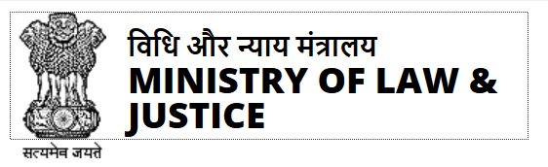
Legal Sector at a Glance
60
Thousand of Pending Suprement court cases
45
Lakh pending high court cases
314
Thousand session court cases
36
Percent vacancy in judges
25
Percent of cases pending over 10 years
Ministry of Low India Report 2019
Notes:
With a large work-force of “knowledge engineers” and 7 billion spending in R&D Bosch is a “warehouse of know-how and knowledge”. Monetizing the contents of this “warehouse” need a methodical approach of digital transformation to convert it from a “warehouse of know-how “ -> “house of know-how”. This digital transformation is about the algorithm and API economy, where by knowledge assets are made “marketable” via digitization. Digital transformation makes these assets more organized, searchable, configurable and adaptable.

Slide 3




Where can AI help in legal Systems In India?
Due Diligence: To review a contract, conduct legal research or performing electronic discovery functions to do due diligence
Legal Analytics: Provides for the data points from past case laws, and also provides judgements and precedent law to be used by lawyers in their present cases
Classification of Case: To classify a case based on the applicable section. This steps avoids a lot of manual interventions
Auto Summarization: to generate an auto summary of the case to be used as reference

Slide 4
Typical Legal Document In India

Slide 5
What are the key Problem Statements – NLP perspective
1
Case Analysis - Identify different set of entities and tags from different source such as Parties, Court, Judges, Act, and Section, Citation (unique identification scheme used by AIR or other legal publishing firm
2
Law Analysis – Extract Relevant Paragraph based on Acts & Sections Applied in the judgment
3
Issue Analysis – With known Act/ Section to Issue mapping, narrowing down to specific Issue
4
Judge Analysis –Find Similar judgments delivered by a Judge
5
Ability to signal if given judgment is in line with proposition or against the proposition

Slide 6
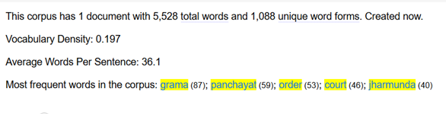
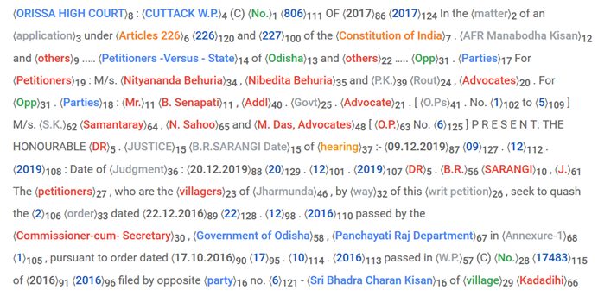
Challenges using NLP tool chains – Understanding the Document (NER, PoS)
Appling existing Toolchains such as NLTK or Stanford or Apache does not yield good accuracies

Slide 7
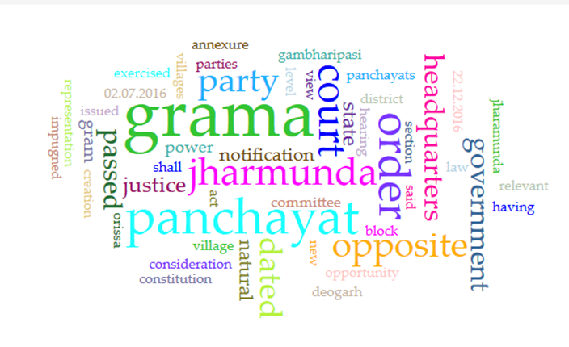
Tag-Cloud using NLP
Existing dictionary of stop words not sufficient. Needs to be modified for the legal system

Slide 8
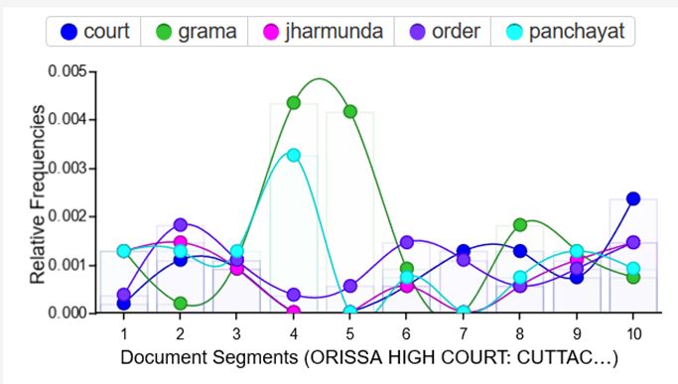
Document Trends using NLP
Gives a picture of the use of keywords in a given context. The accuracy depends on the accuracy of NER / PoS Tagging.

Slide 9
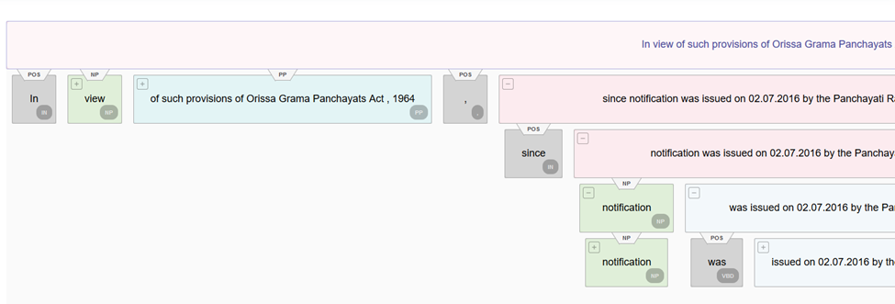
Document Parsing using NLP
Standard tool chains do not yield accurate segmentation and parsing of the document

Slide 10

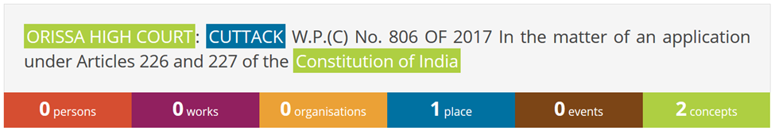
Named Entity Recognition using NLP
The models used are not trained for legal document structure and vocabulary

Slide 11
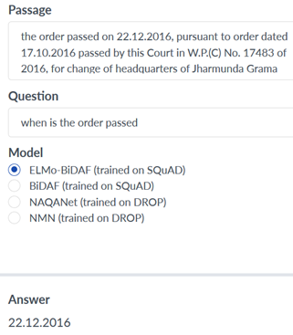
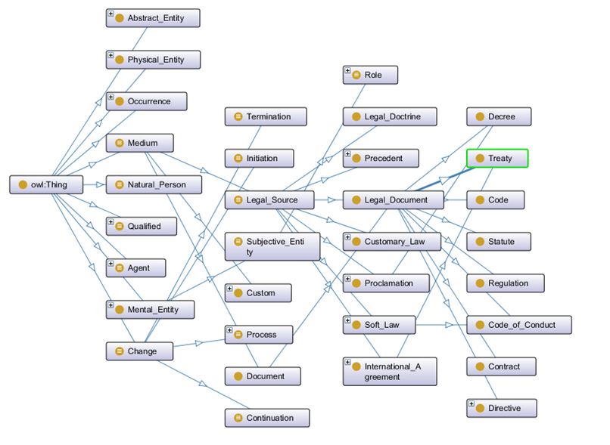
Q&A using NLP
Need to build a complete ontology that meets the legal structure in India

Slide 12

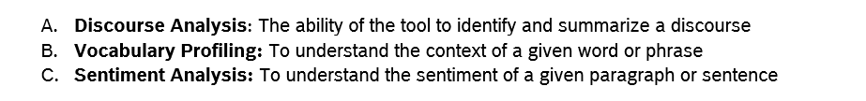
Vocabulary Analytics using NLP
There are several limitations using the current models to effectively generate results

Slide 13
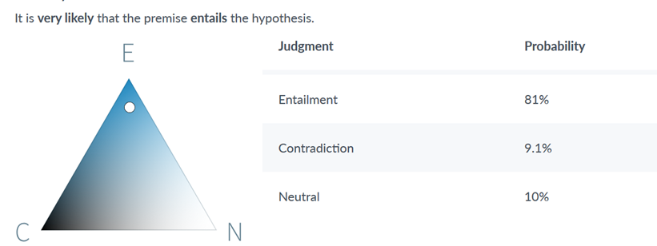
Text Entailment using NLP
5
Ability to signal if given judgment is in line with proposition or against the proposition
Again several limitations using the current models of text entailment

Slide 14
In conclusion
1
Basic models – Improve the basic models of NLP such has NER, PoS, tagging, segmentation etc.
2
Quality Data – There is a need to generate quality ground truth via manual annotations
3
Label Propagation – While is impractical to annotate all the data, label propagation methods can help
4
Re-training – The AI models need to be re-trained
5
Validation- he new models need to be validated on actual data

Slide 15


Reach out to us
This is a very large effort. If you wish to contribute please reach out to us
abhijit.mlele@gmail.com
Data and Domain Experts
Technology Advisor

