Slide 1
Ather
Soft Things about Hard Things

Slide 2
About Ather
Notes:
The title is a play on Hard things about Hard things by Ben Horowitz a book which talks about the hard aspects of growing and running a business especially a startup. Great book to know about the not so romantic side of running a business.

Slide 3
Ather Energy
FOUNDED
2013, IIT Madras
FOUNDERS
Tarun Mehta
Swapnil Jain
FUNDING
$95 Million
Hero MotoCorp
Tiger Global Sachin & Binny Bansal (founders of FlipKart)
EMPLOYEES
850+
PRODUCT PORTFOLIO
Fast intelligent electric scooters & EV charging network
MARKETS
Bengaluru Chennai Hyderabad Pune Mumbai Delhi NCR Ahmedabad Kolkata Kochi Coimbatore
PATENTS PORTFOLIO
244
115
115
113
109
Indian Patent Applications
International Patent Applications Filed
Indian Design Registrations
International Design Patents
Indian Trademarks

Slide 4
Pioneering the effort
Designed and built from scratch
Changing the image of electric vehicles in India
Every component built to fit the needs of a consumer
Consumer centric ownership experience

Slide 5
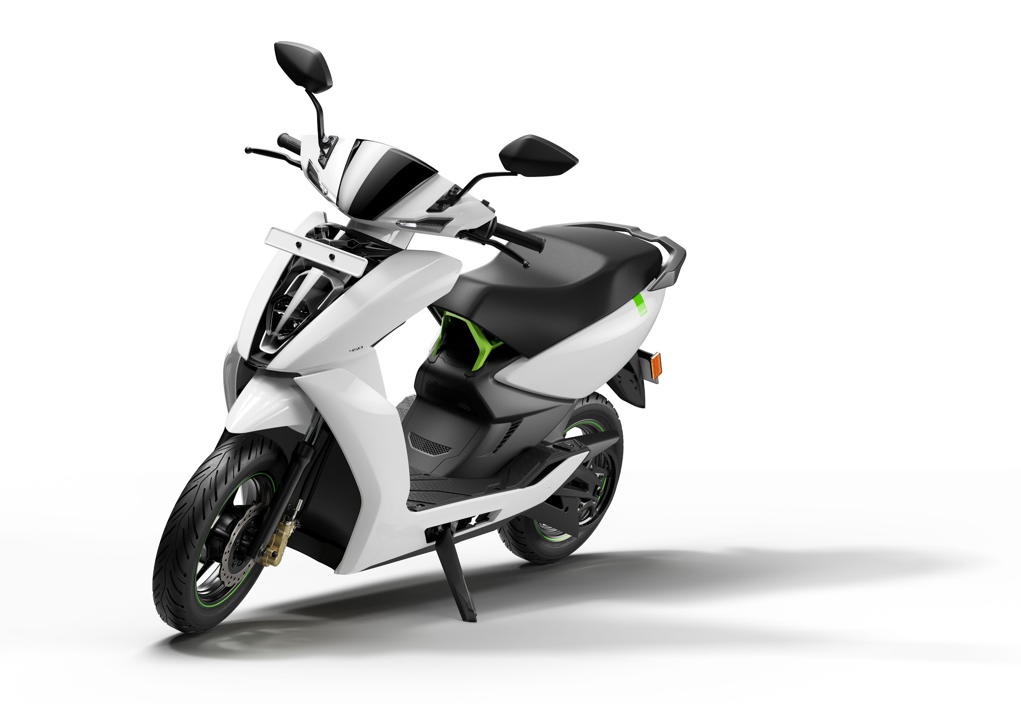
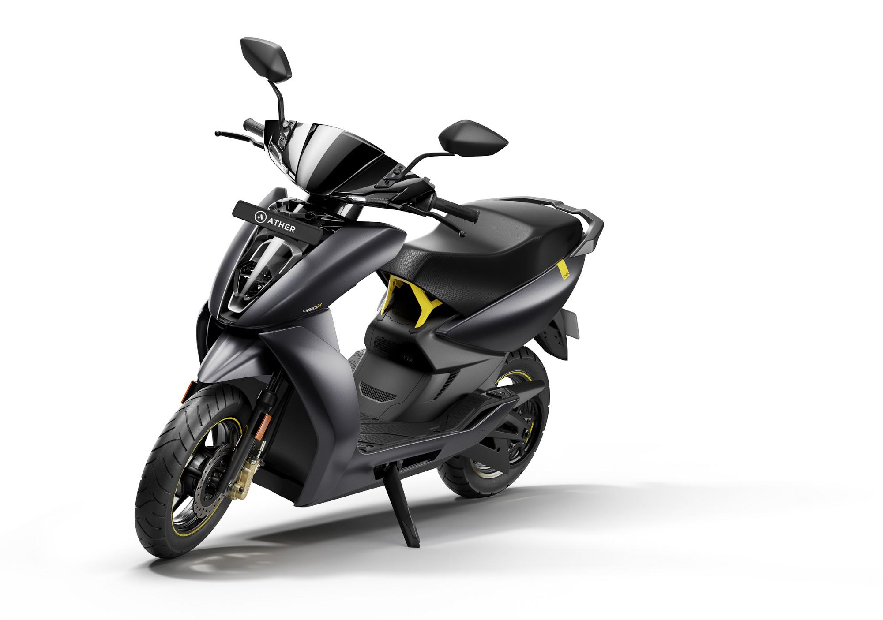
Product Portfolio
Ather 450
Ather 450X

Slide 6
Ather 450X
3.3 sec
0-40 kmph
80 kmph
Top Speed
4G
Connectivity
85 km
True Range
7”
Touchscreen Dashboard
Bluetooth
Connectivity
116
Projected IDC Range
On-board Navigation
Over-The-Air
Upgrades
21º
Gradeability
Parking Assist

Slide 7
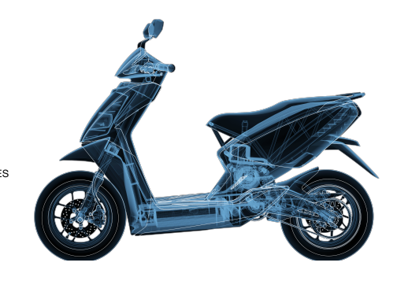
Electronics inside Ather
Connectivity module
Dashboard with 7” touchscreen display
Power modules
DC/DC convertor, Motor controller, Charger
Digital modules
BMS, Peripheral control node, Charging Infra
Lighting modules
LED lights

Slide 8
Future of EV’s

Slide 9
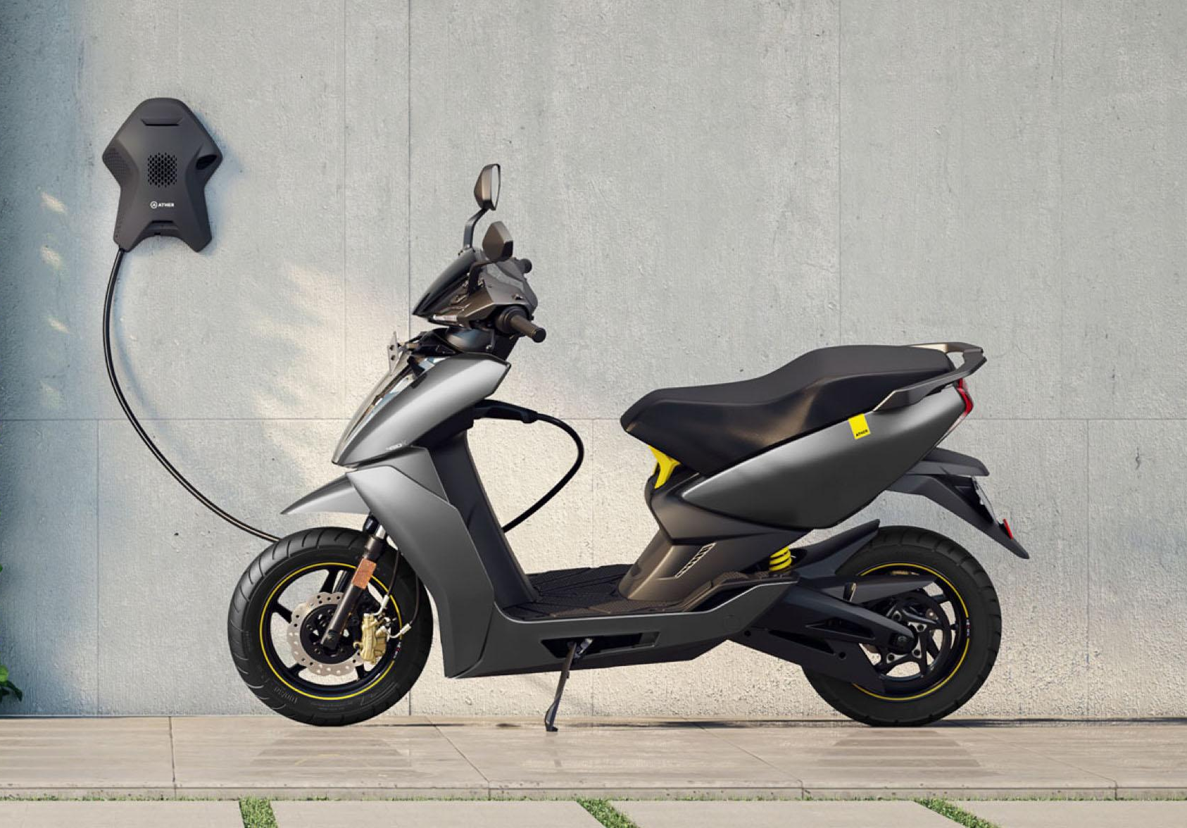
Future of EV’s
SoCs specifically designed for Automotive applications
Components to support Power efficiency, extreme ambient performance & size
Cheaper and faster ways of communication
Notes:
The need for SoCs which are specifically intended for Automotive applications will become critical drivers to reduce cost and speed up product development
Power efficiency, extreme ambient performance and size will become the most sought out requirements
Cheaper and faster way of communication within the vehicle will be critical for smart vehicles which would demand need for newer communication standards

Slide 10
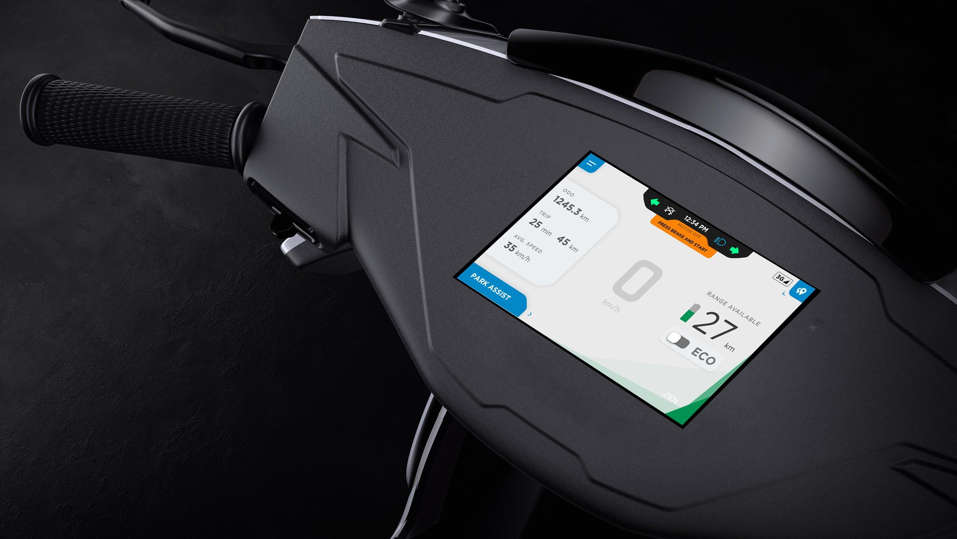
Connected & Intelligent
Enabled by intelligence
7” interactive touchscreen dashboard
On-board Navigation
Over-the-air updates
Connected to mobile app
Remote diagnostics
Connected charging experience
All systems connected

Slide 11
Connected & Intelligent
Connectivity Highlights
Purpose
To enable transmission of data between the vehicle and the cloud and the capability to manage OTA
Key Features
Edge Connectivity
Transmission of data
Local storage to mitigate for network disturbances
OTA Updates
Enables capability to send OTA packages
Creates ability to rollback to previous versions
Allows controlled testing of updates

Slide 12
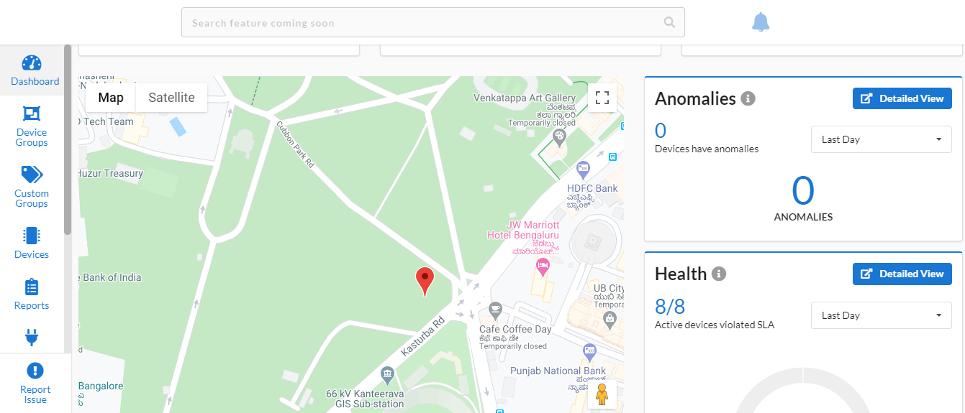
Connected & Intelligent
Connected Ecosystem
Connect
Control
Analyze
Connect

Slide 13
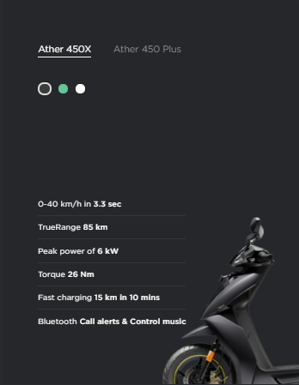
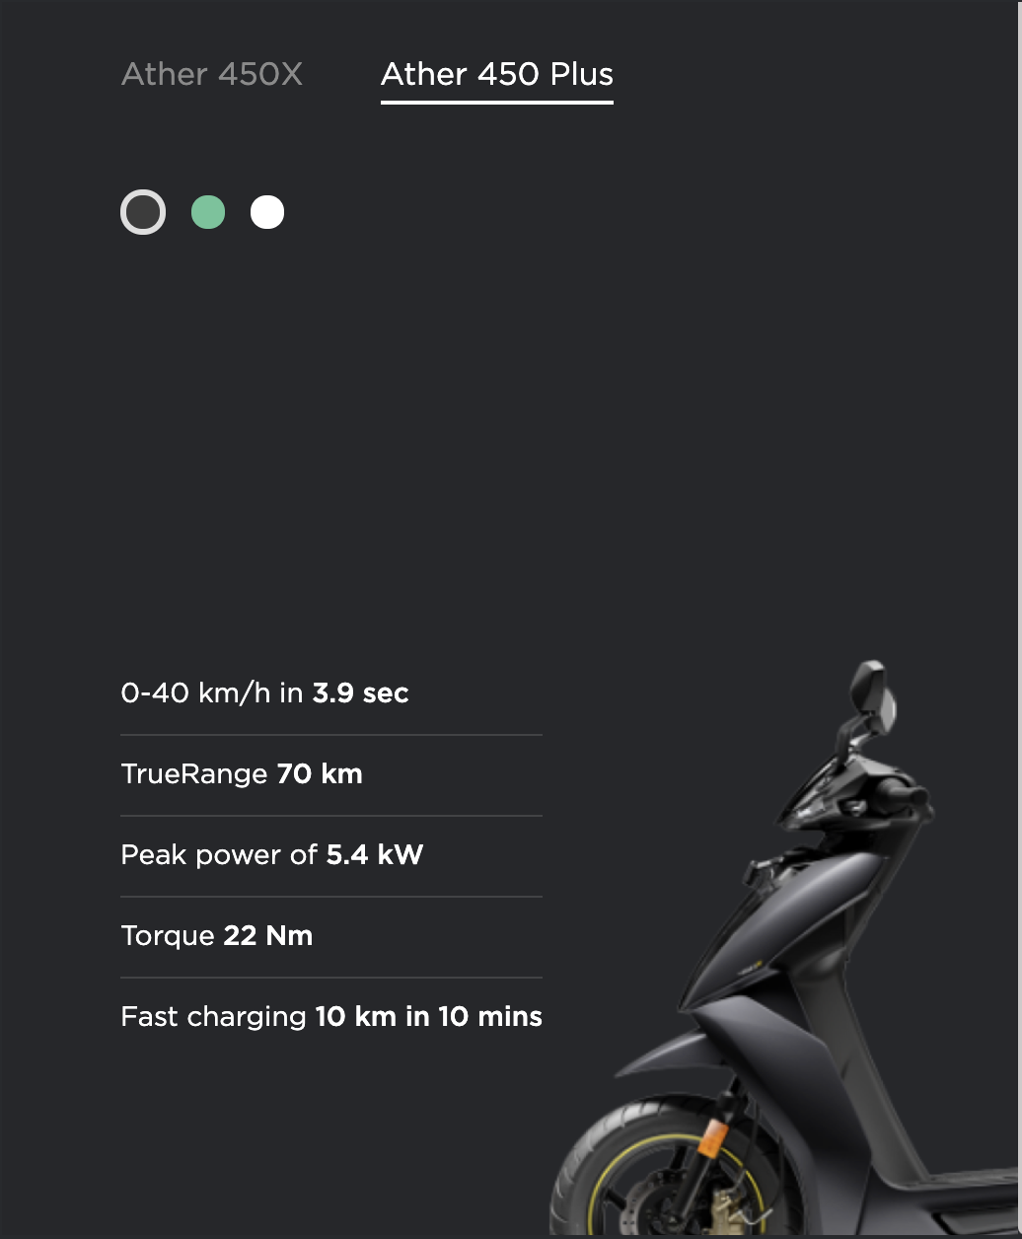
Connected & Intelligent
Connected Ecosystem
Connect
Control
Analyze
Control

Slide 14
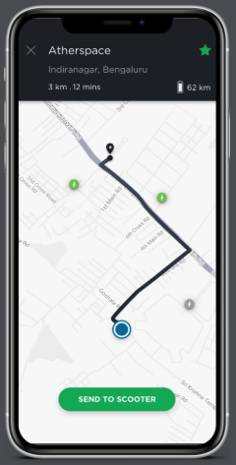
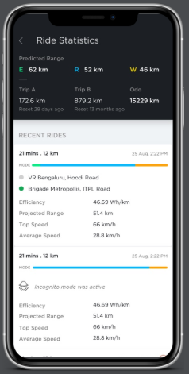
Connected & Intelligent
Connected Ecosystem
Connect
Control
Analyze
Analyze

Slide 15
Key Technologies

Slide 16
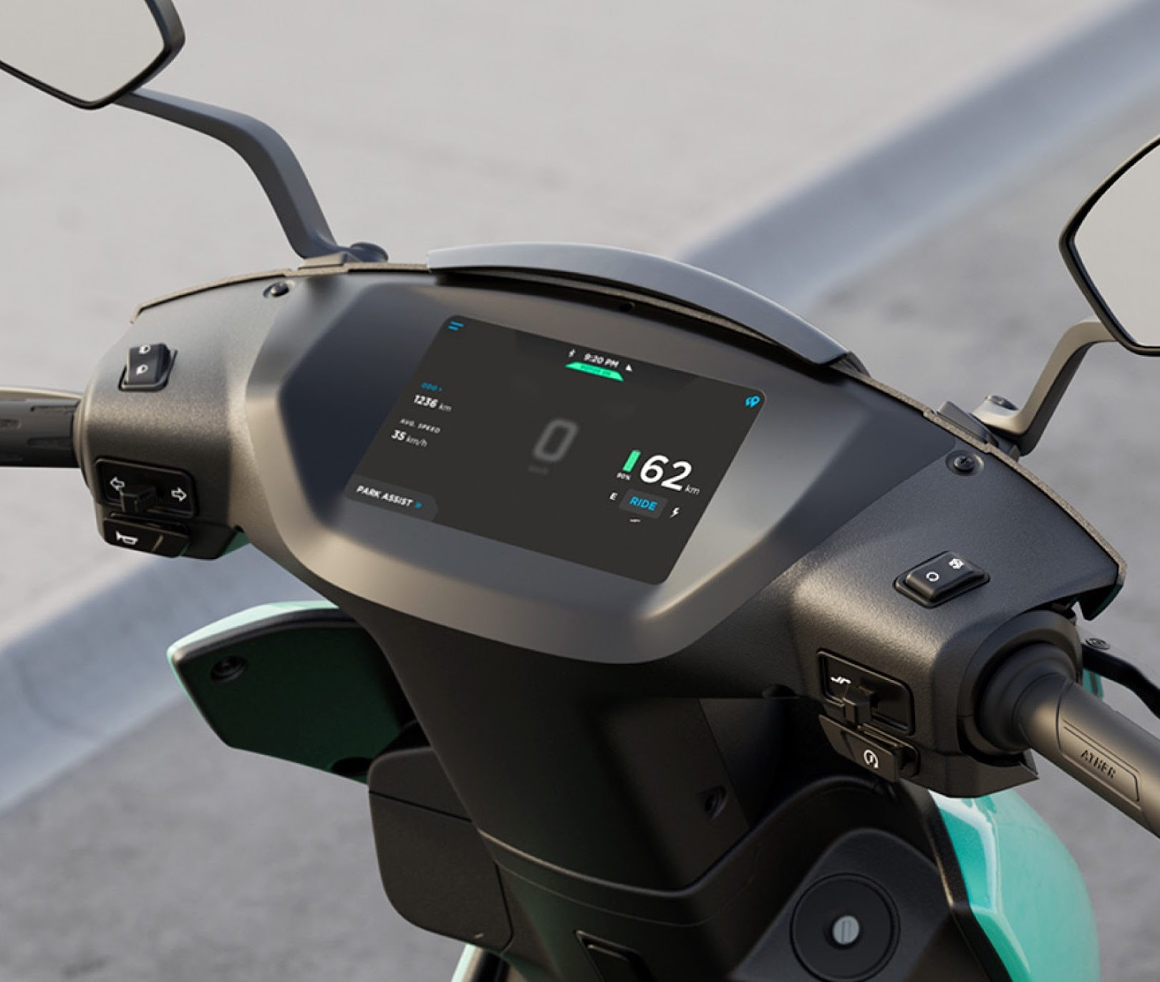
Key Technologies
Serverless Architecture
Functional Programming
AI/ML
Internet of Things
OTA
Progressive Web Apps
MQTT
Data Lake Architecture

