Slide 1
Google Cloud Migration Tools & Services

Slide 2
Google Cloud Migration Tools & Services

Slide 3
VIDEO 8.2

Slide 4
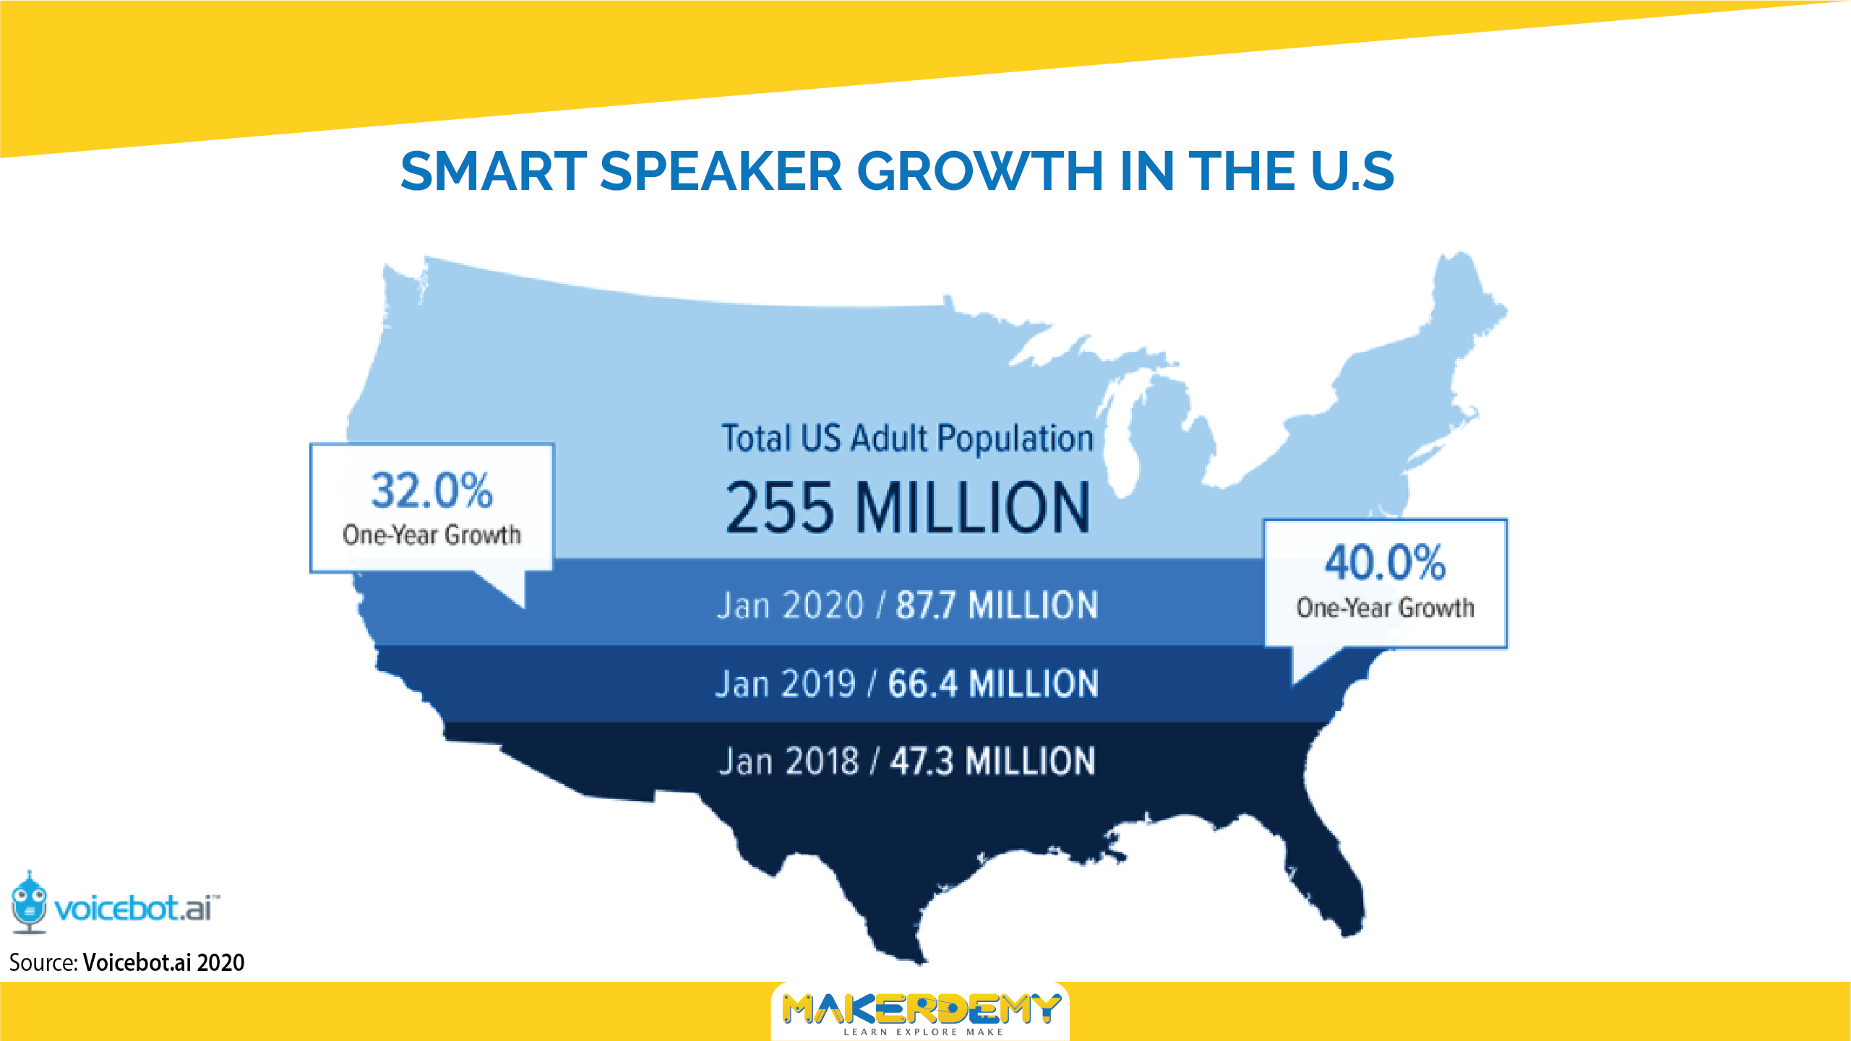
VIDEO 8.2

Slide 5
Google Cloud Migration Tools & Services

Slide 6
Google Cloud Migration Tools & Services

Slide 7
Google Cloud Migration Tools & Services

Slide 8
VIDEO 8.2

Slide 9
Google Cloud Migration Tools & Services

Slide 10
Google Cloud Migration Tools & Services

Slide 11
Google Cloud Migration Tools & Services

Slide 12
Google Cloud Migration Tools & Services

Slide 13
VIDEO 8.2

Slide 14
Google Cloud Migration Tools & Services

