Slide 1
Scope of Block Chain in Pandemic & Future Opportunities
Satya Prakash Koppaka
Certified Blockchain Expert
Advisor Blockchain Startup Ecosystem
Saccha.Koppaka@gmail.com
https://www.linkedin.com/in/satyakoppaka/itter:
Twitter: @SatyaKoppaka14

Slide 2
communications
transformation
secure immutable digital ledger
Blockchain
exchange
analytics
transfer
data trust
digital banking
knowledge
distributed ledger
anonymous
transaction
security
Notes:
Good Day everyone!
I’m here to talk about Blockchain and Distributed Ledger. Before we do, I think it is important to touch on a variety of emerging technologies shifting the way the world operates.
I think we can all agree that IoT is generating a massive amount of data.
We also know that AI/ML/DL can help make sense of that data for rapid business insight.
Even technologies like AR/VR will make use of this data in order to maximize opportunity at the point of visualization.
But how do we ensure that the data leveraged can be trusted? The source verified? The integrity kept in check?
As we continue to shift to a disaggregated world (think our own edge to core to cloud message), how can we best manage the entire process of data flow and exchange?

Slide 3
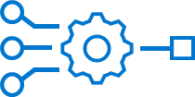
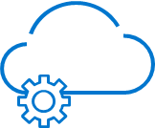
Append only digital ledger
Leveraging encryption
With business logic & rules
Enforced using Smart Contracts
Geo-distributed consensus
Blockchain
Immutable and secured
Abundance of use cases
is about ensuring data and trust.
Notes:
Why should you care? Lay out the emerging opportunity blockchain represents.
But in 2015, the industry began to see new business to business blockchain implementations, which were NOT focused on cryptocurrency, but were instead focused on the “characteristics of blockchain”:
(a) the use of cryptography
(b) immutability
(c) geo-distribution
People wanted all of these features AND SOMETIMES a different (non-crypto) payload. Businesses began to realize that underlying blockchain technology powering Bitcoin can also be used for:
(d) Smart contracts
(e) off-chain data assets (such as Systems of Record, applications, external data, etc.)
These final two points allows us to re-purpose blockchain for multiple use cases that require trusted handling of off-chain data assets that span many emerging technologies including IoT, AI/ML/DL, and even multi-cloud. This new evolution is all about things transacting with things.

Slide 4
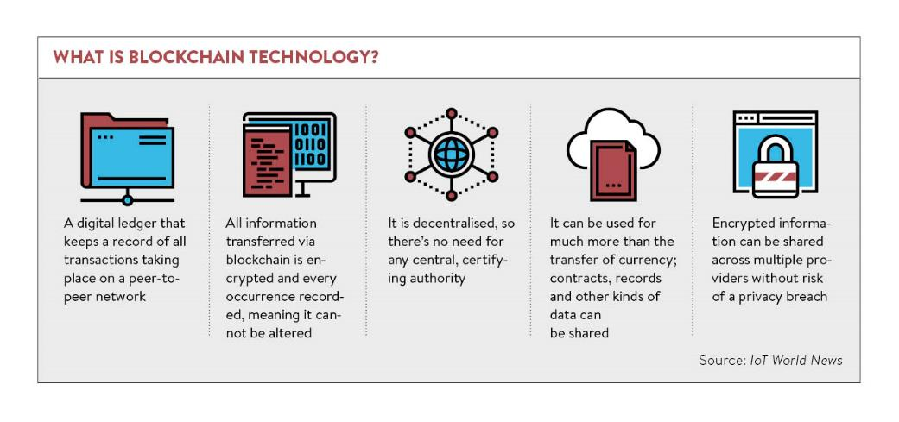
Rewrite Application
The blockchain is the new database – get ready to rewrite everything
Notes:
The blockchain is the new database – get ready to rewrite everything…
Well, not really. The technology concept behind the blockchain is similar to that of a database, except that the way you interact with that database is different.
Blockchain technology leverages a decentralized consensus model and powers applications that can take advantage of this technology. By default it can be geo-distributed, leverage token based access, store all transactions cryptographically, and even operate autonomously.
While not for everything, there are lots of applications that do fit the blockchain distributed model, and that presents a massive amount of opportunities for developers, creators, and visionaries.
Lets explore further…

Slide 5
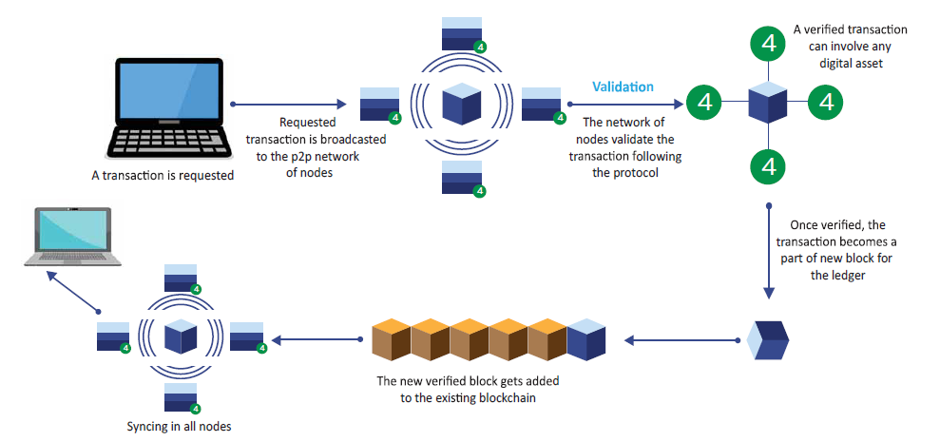
How does it work?
Notes:
So how does blockchain work? At the most basic level, a source party wants to request a transaction. That transaction is represented online as a block. This block is then broadcast to all participants in the network or “Chain”. All participants in the network approve the transaction or block as valid. Once approved, it can now be added to the chain. The transaction is then complete. While commonly thought of as a means for secure financial transaction, there are many other current and potential uses for blockchain technology.

Slide 6
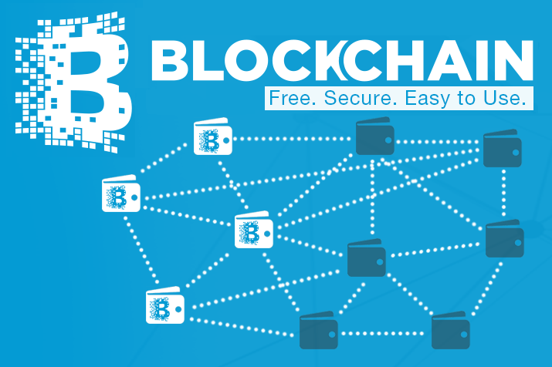
Blockchain…
Why is this so impactful?
Fundamentally changes the way companies will communicate and transact
Will absolutely disrupt every industry even by as little as changing the method they handle payments
Will drive a massive amount of new businesses and offerings
Every company / govt / business will use blockchain by 2025
Notes:
Why is blockchain technology so impactful?
[Read bullets from slide]
Every one of your customers will end up using blockchain in some form or fashion, and more than likely will drive significant investment from companies to establish a method of participation via public, private, or combination thereof.

Slide 7
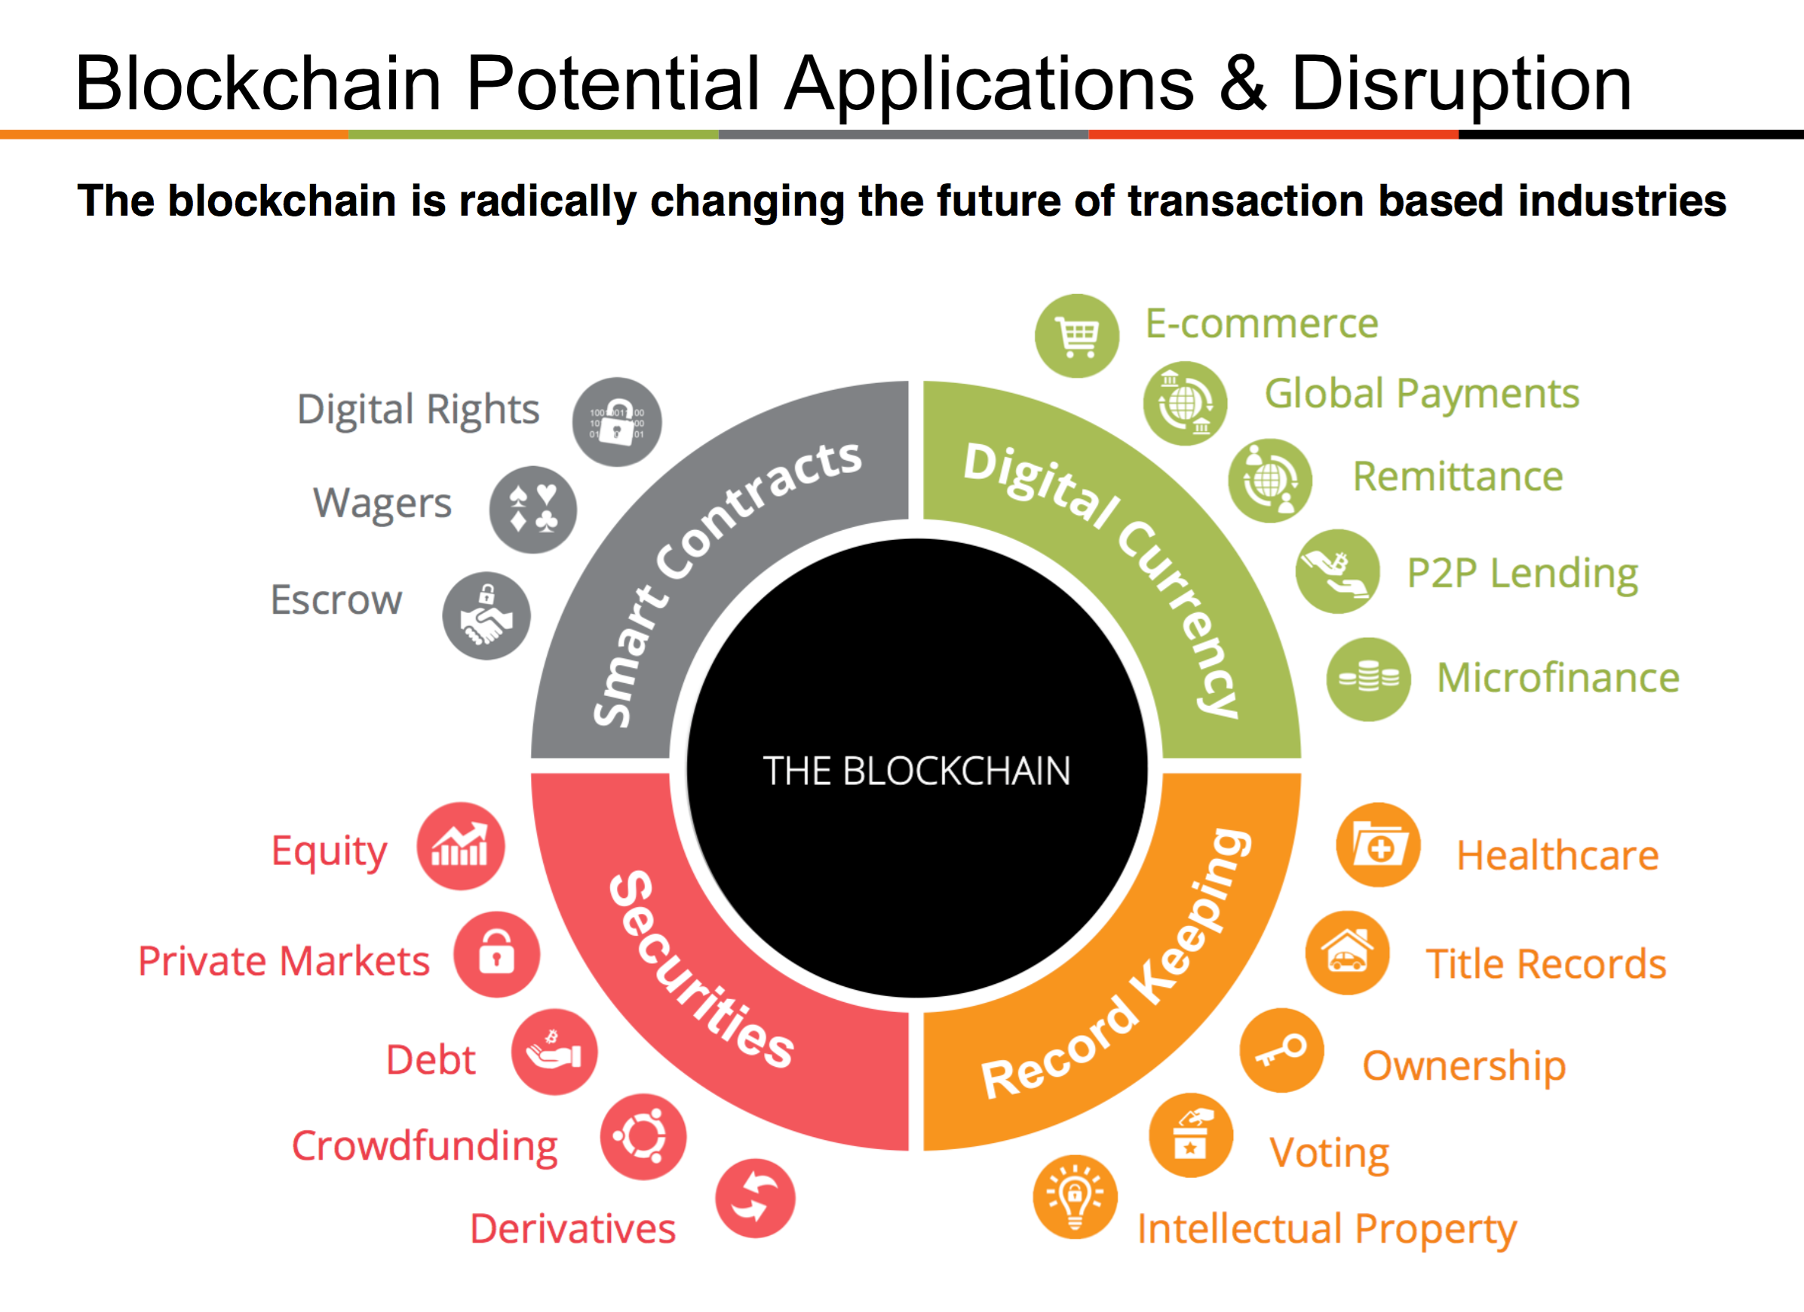
Notes:
Multi or fractional car ownership or shared leasing of autonomous vehicles, secure and verified voting via mobile, smart contracts, even HIE and patient data can be shared securely. Elsewhere in the blockchain space, applications related to decentralized energy distribution have been gaining steam.

Slide 8
Using blockchain to fight the pandemic COVID-19
Health Records and Data
Individual Identity ,Travel History data
Medicine Supply chain
COVID-19 Vaccine research data sharing
Digital certificates for People Positive/ Negative/symptoms/ using apps
Containment zones movements data
Asset Tracking like ventilators ,PPE Kits, Hospital management
Notes:
How is blockchain impacting and integrating with other emerging technologies? Lay out the integration aspects.
In the examples shared, there are many moving pieces making the business goals and objectives reality. While blockchain plays a part in these initiatives, they also are leveraging other emerging technologies to drive change and innovation. Blockchain is being woven into these digital and intelligent ecosystems as the framework for communication and transaction.

Slide 9
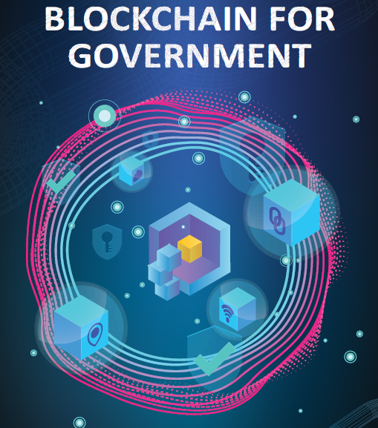
Govt of India Setup Blockchain COE
Jan 2020 – Bangalore
Some of India Govt use cases :
Blood Bank Management System
Public Distribution System ( Ration )
e-Judiciary
Urban Property Management System – e-Aasthi
Land Record Management System
State Excise Supply Chain -e-Abgari
Online Supply Chain Management systems for Drugs certificates verification system - Aushada

Slide 10
Blockchain –as –a -Service Govt of India Offering

Slide 11
Building Blocks
Use Case Rationalization
1
Multi-Cloud Ecosystem
11
2
Smart Contracts
Multi-Chain
10
3
Identity Management
Blockchain
Hybrid Integration
9
4
Key Management
Data Protection
8
5
Network Programmability
7
6
Off-chain Storage
Consensus Algorithms
Notes:
As a method for communicating our value as Dell Technologies with our customers, we always lead with a conversation around what we like to call the “Pinwheel of Consideration”. After all, companies are not looking at blockchain to replace some back office process such as email. They are looking to revamp mission critical business systems and processes with this technology. And because this is the case, blockchain really sits at the intersection of many other ancillary pieces of technology necessary to realize the potential of a production implementation.
I want to make it clear that in this presentation we are talking about blockchain as part of a set of emerging technologies. But it is also true that our customers are investing in building blockchain applications right now, and in 2018 there is an immediate business opportunity to capture revenue across the DT portfolio.
Additional info:
When interfacing with our customers, we always lead with a conversation around what we like to call the “Pinwheel of Consideration”. After all, companies are not looking at blockchain to replace some back office process such as email. They are looking to revamp mission critical business systems and processes with this technology. And because this is the case, blockchain really sits at the intersection of many other ancillary pieces of technology necessary to realize the potential of a production implementation. Much like a Hadoop cluster, if you simply stand up Hadoop and wait for magic and rainbows to come flying out, you will be sorely disappointed. The truth is that it is not until your interface Hadoop with various data systems, and understand the right questions to ask of the data, that you recognize any value. Similarly, blockchain by itself does nothing. In fact, the technology is not all that revolutionary. It is simply an aggregation of various things such as encryption, geo-distributed database, etc. that were previously cumbersome to implement at scale.
For example, with new business process comes business logic and rule sets that need to be defined and enforced with the power of smart contracts in the form of software code. Additionally, with private enterprise blockchain, managing membership and the issuance of public and private keys for participation is of concern. With developments in quantum computing and the constant threat of network penetration, leveraging software defined networking to improve upon security and programmability is key to a successful and secure implementation. Many cite the scalability issues facing Bitcoin. The truth is that Bitcoin is under constant attack from hackers every second of the day. Thus, Bitcoin is forced to leverage extremely complex and cumbersome algorithms to ensure data security. When using private enterprise blockchain, different less stringent algorithms can be used, sacrificing a small amount of security to allow for improved scalability and throughput.
Large amounts of data or large data files will not be stored within a blockchain. It is after all geo-distributed which would not be functional if the data stored was extremely large. Interfacing with information stored off-chain and in legacy systems is key to interoperability and functionality for blockchain implementations. And of course that data must be protected through a variety of methods. Companies looking to run both private enterprise blockchain along with say accepting cryptocurrency as forms of payment will rapidly encounter a multi-chain world they must contend with. And this naturally lends itself to design and architecture considerations around multi-cloud and automation and locality of blockchain nodes.

Slide 12
Blockchain Platforms OpenSource & Enterprise
1.Ethereum
2.Hyperledger Fabric
3.IBM Blockchain
4.Multichain
5. R3 Corda

Slide 13
Careers Opportunities
Learning Fundamentals of blockchain
Certification on Platforms Hyperledger /Ethereum
Startup ecosystem – Ready to take freshers based on Programming talent
SupplyChain / Healthcare & BFSI applications are first movers using blockchain
Over 20000+ Jobs on Career websites as of today in India.
A PwC report says, 56% of Indian businesses are inclined to make blockchain a part of their core business.

Slide 14
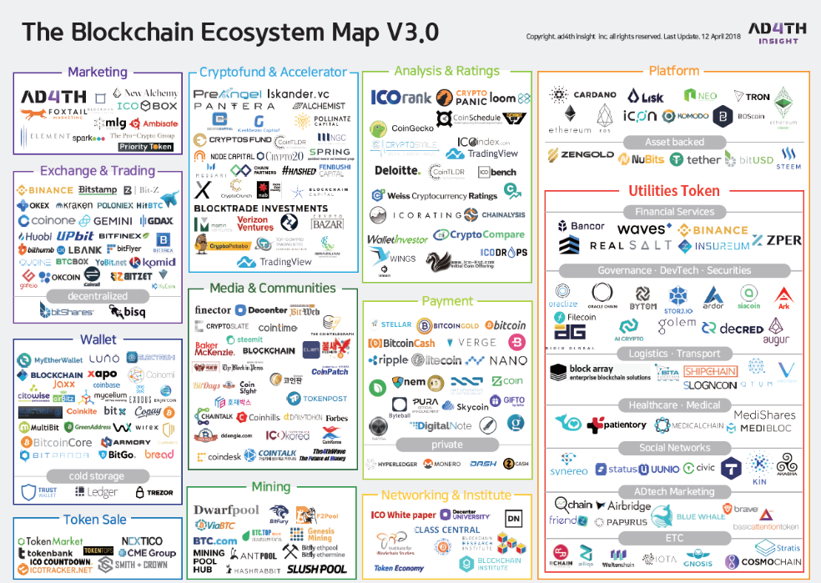

Slide 15
Satya Prakash Koppaka Certified BlockChain Expert Advisor BlockChain Startup Ecosystem Saccha.Koppaka@gmail.com https://www.linkedin.com/in/satyakoppaka Twitter: @SatyaKoppaka14
Thank You

