Slide 1
…Bringing
Ideas to life…
18 June 2020 15.00 hrs to 15.30 hrs
Dr. Guruprasad Rao

Slide 3
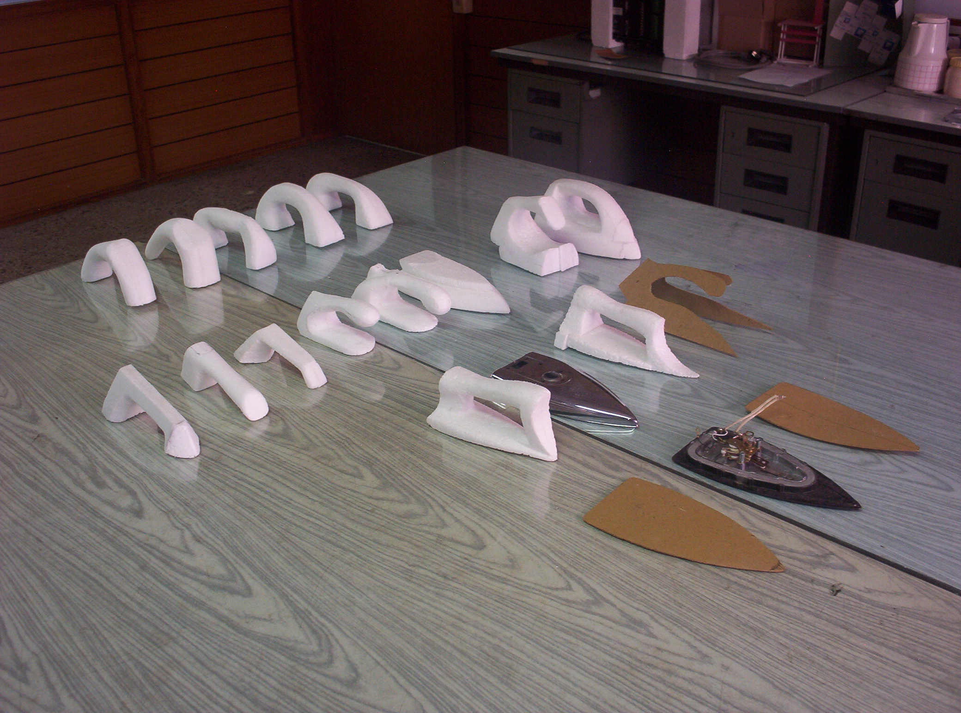
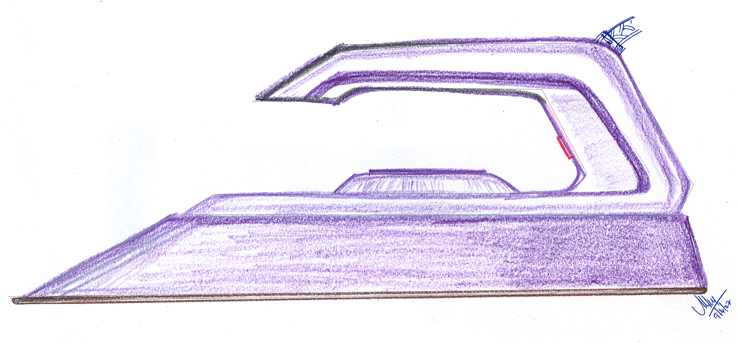
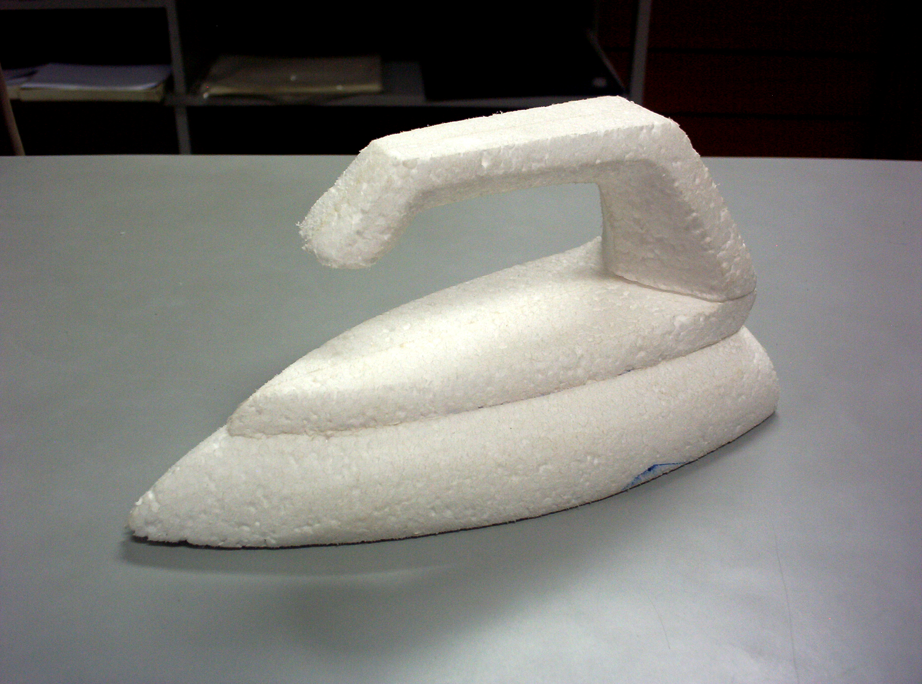
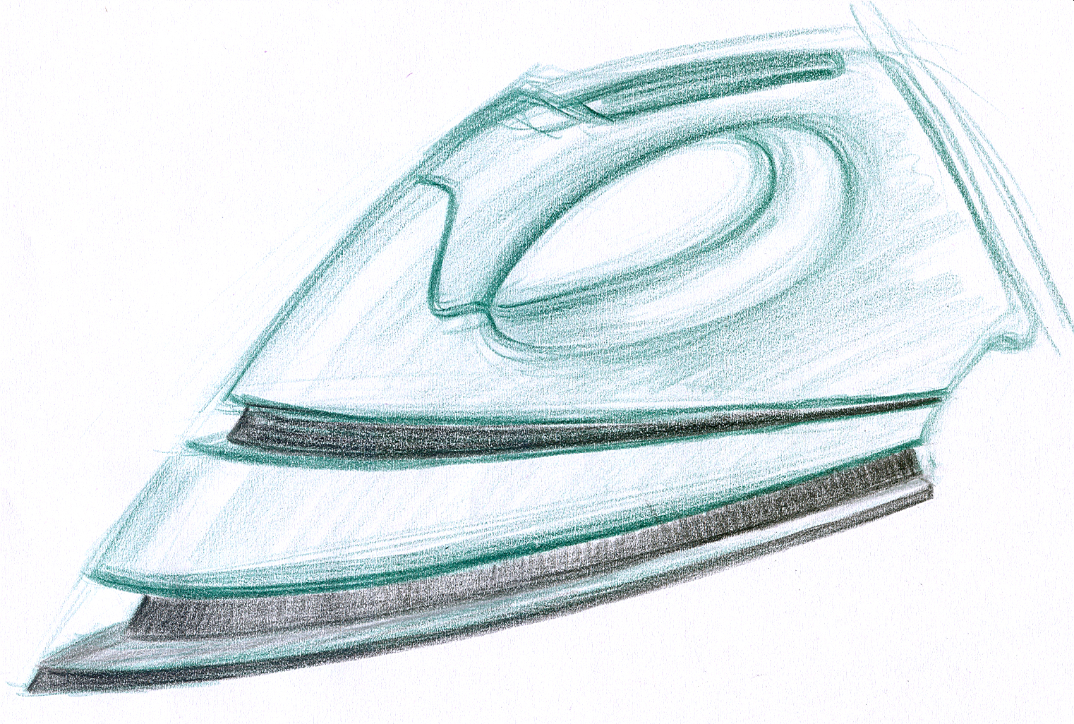
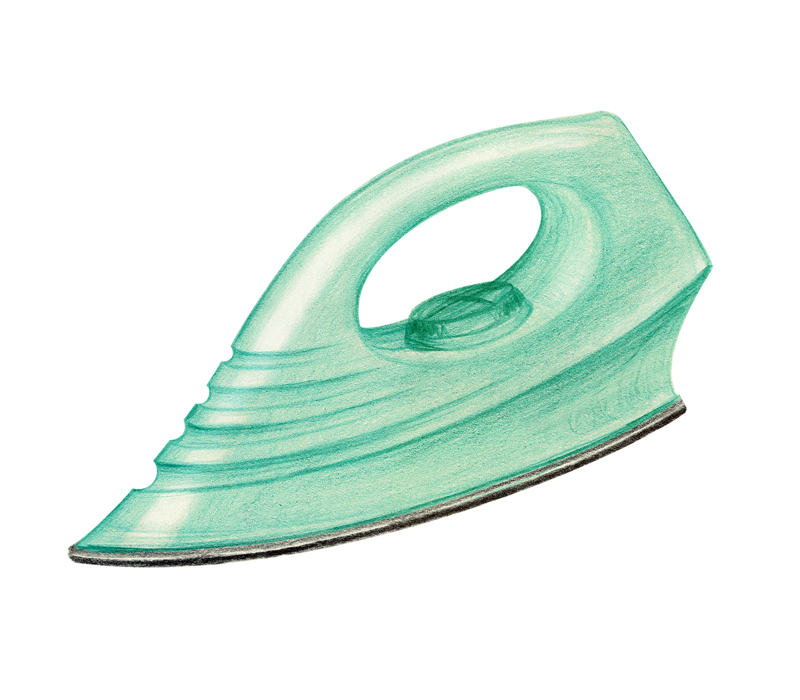
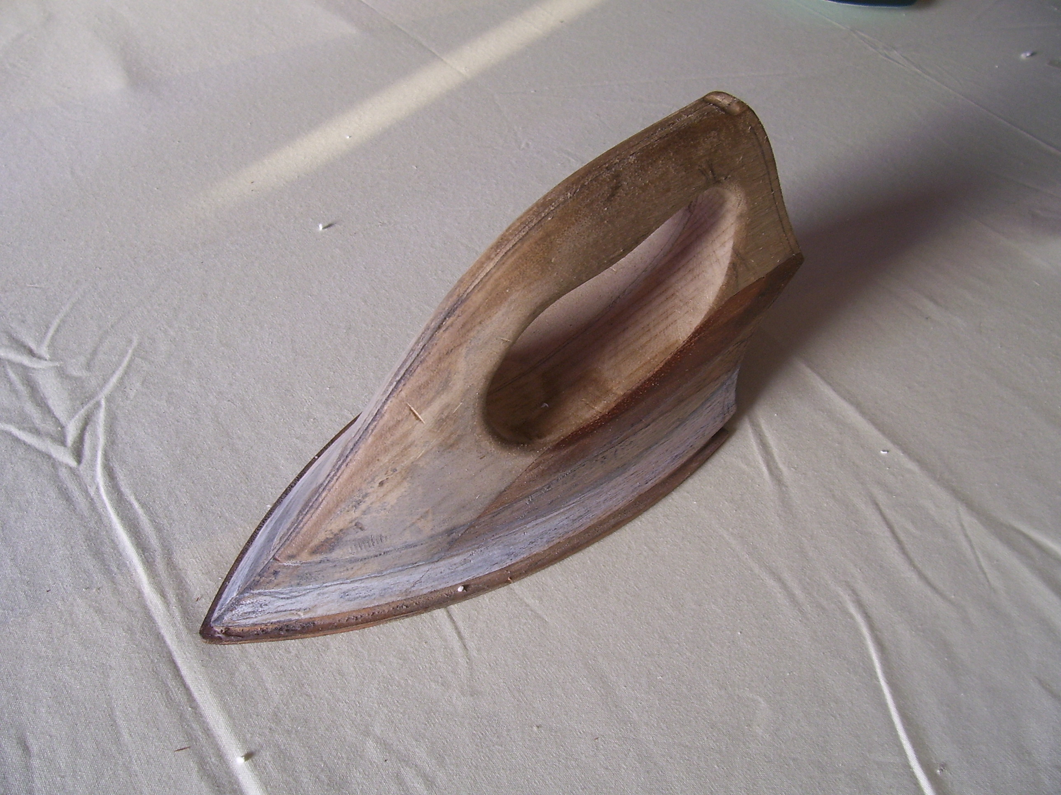
Designing is an iterative process

Slide 4
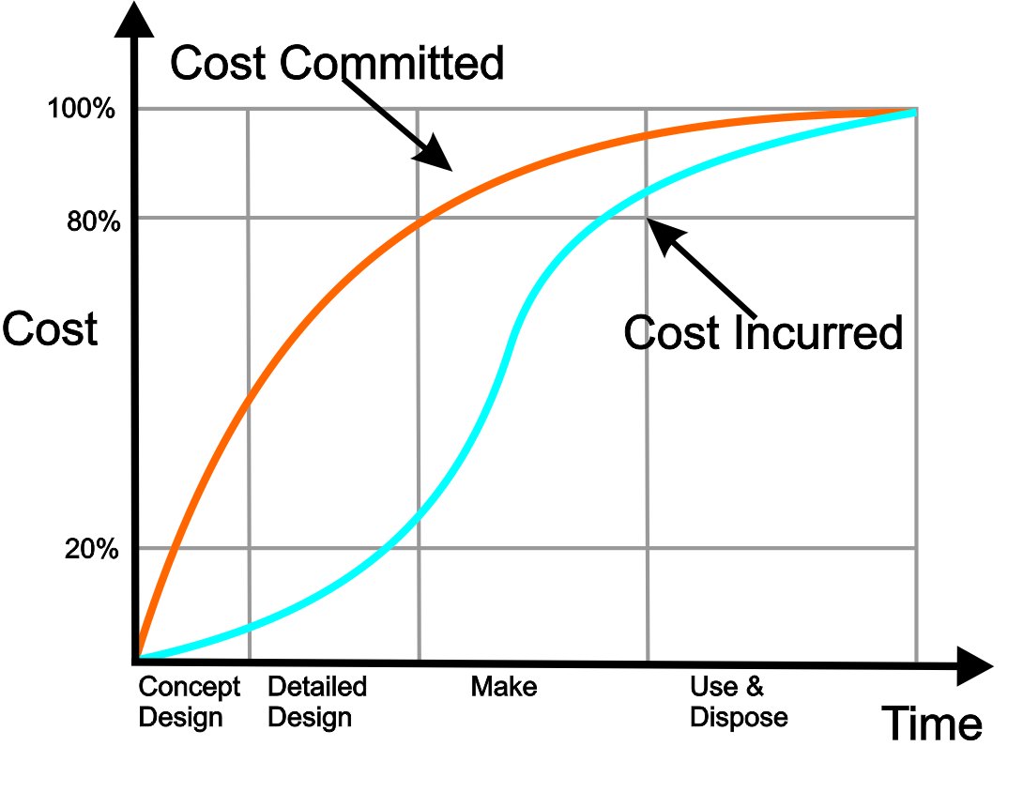
Business Case : Why we need to test ideas

Slide 5
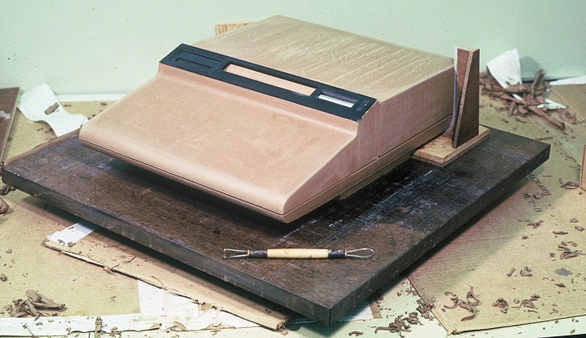
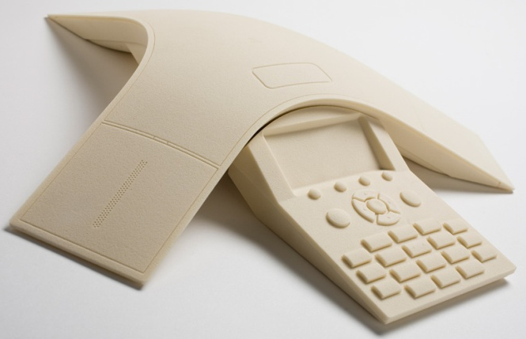
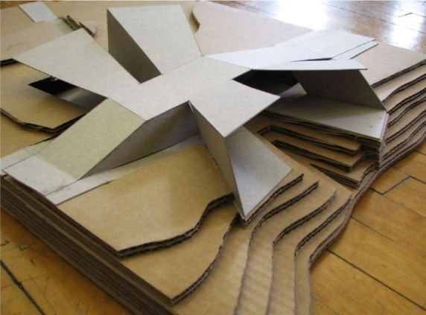
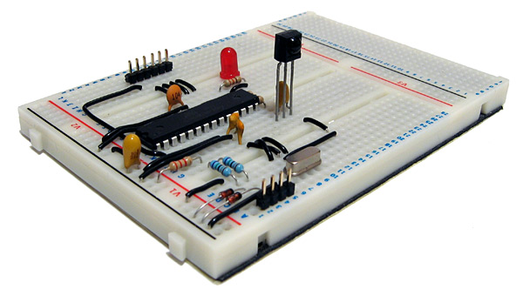
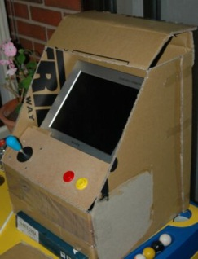
Different types of prototypes at different stages of the product development process.

Slide 6
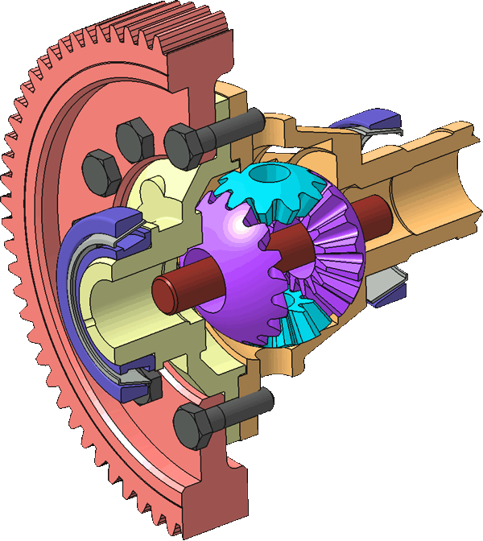
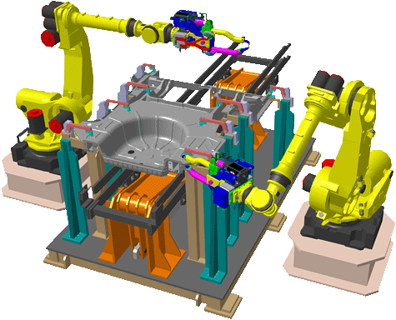
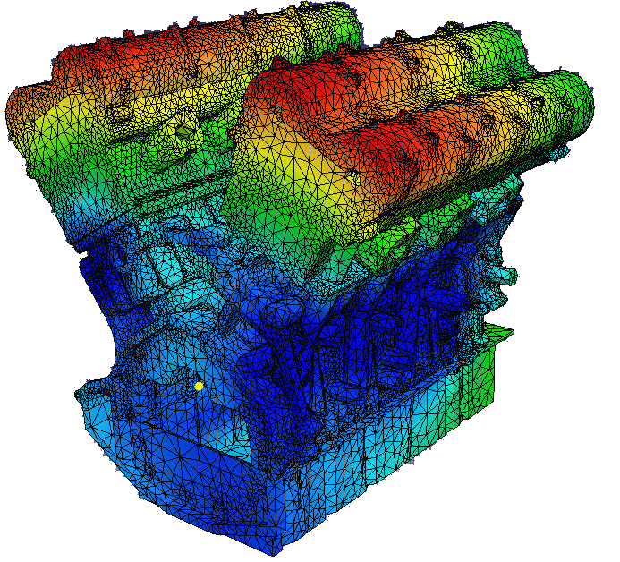
While Virtual Models help visualize the concepts and analyze for collision, heat transfer, induced forces and kinematics,
Real models in hand provides the touch and feel to take a hard business decision will always be needed before one invests into very costly tooling

Slide 7
Production Technology :
Art of Making Things

Slide 8
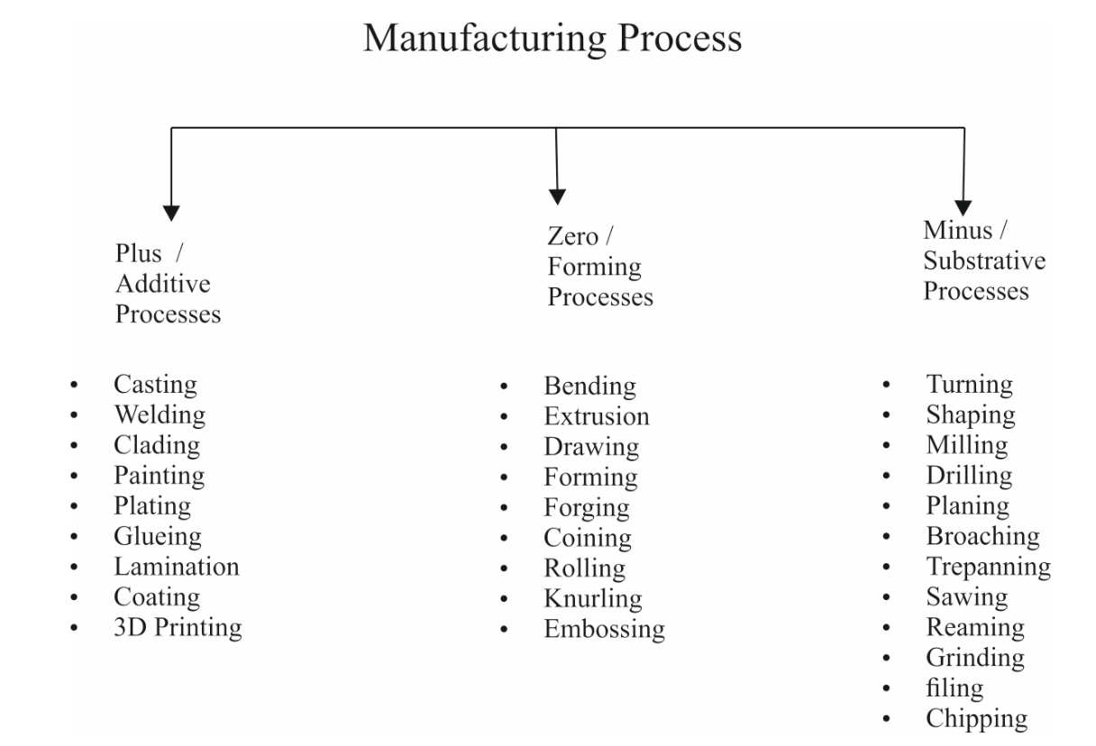

Slide 9
3D Printing – Is it a Disruptive Technology ?

Slide 10
According to Mr. Derin Cag, …the trending Disruptive Technologies for 2019 are :
AI
VR
3D Printing
Blockchain
IOT
Robots
Autonomous Vehicles
Biomedical Engineering
Highspeed Travel
Space colonization
Renewable Energy

Slide 11
Ms. Lauren Harrington in 2018 came with an article :
“5 Disruptive Technologies Shaping Our Future”
and listed them as:
Artificial Intelligence
Blockchain
3D Printing
Virtual/Augmented Reality
Internet of Things

Slide 12
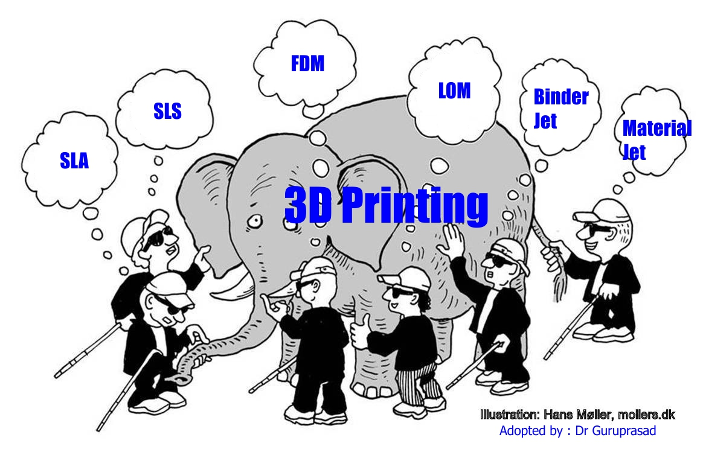
Factory on Cloud
Future Driver ….Need to build
MSE , OEMs
Design House, SME
Small &
Medium
Large Sized
Individual designer / Maker / Artist

Slide 13
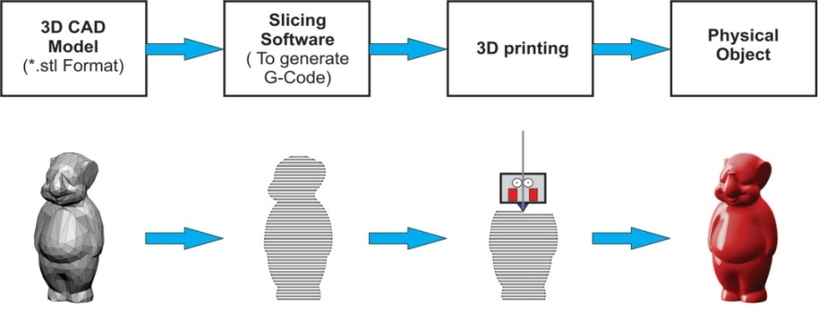
Technology Definition
3D printing refers to a set of technologies which help to fabricate 3D objects layer by layer from digital input data . The inputs could be a 3D model / Medical Image slice data / Point cloud from a scan.

Slide 14
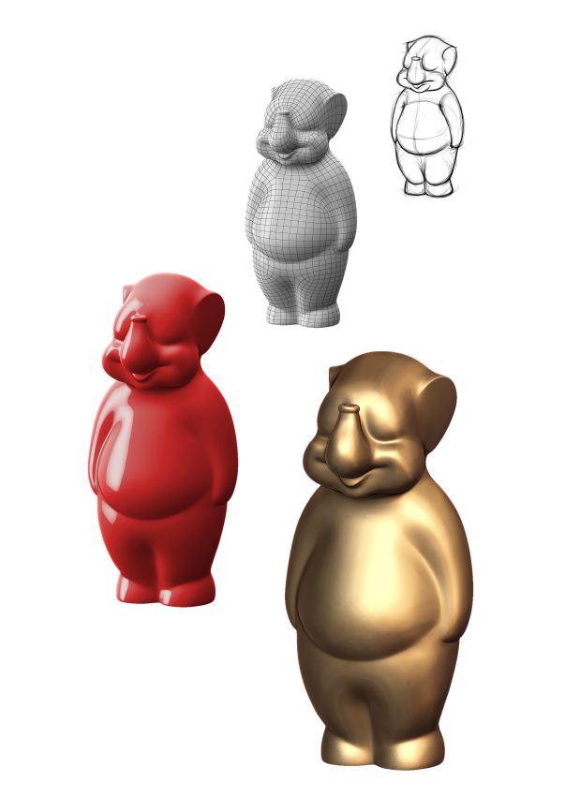
Art to Part

Slide 15
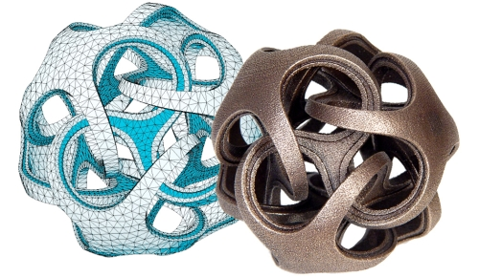
Create directly from CAD to PART

Slide 16
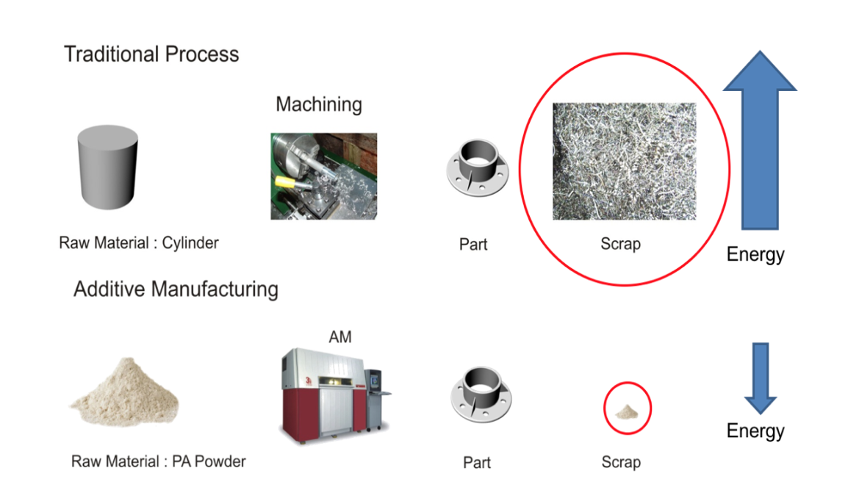

Slide 17
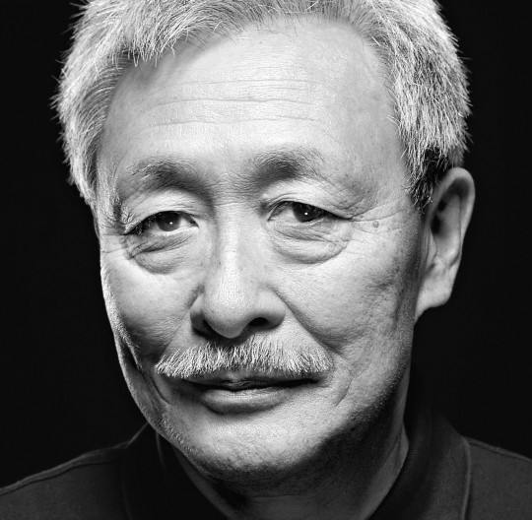
3D Printing Pioneers
1981
1986
1989
1989
Dr. Hideo Kodama
Chuck Hull
Carl R. Deckard
Steven Scott Crump
RP ? SLA SLS FDM

Slide 18
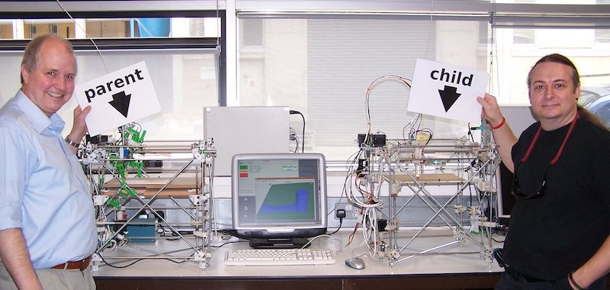
Dr. Adrian Bowyer in 2005 started a open-source initiative to create a 3D printer that had the ability to build itself !
He aptly named this ‘The Replication Rapid-Prototyper Project‘ (RepRap for short).

Slide 20
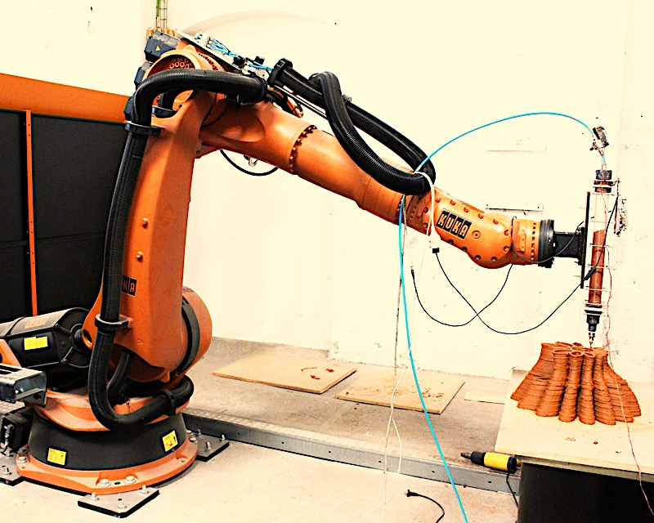
Robot as a 3D Printer – Out of the box Printing

Slide 21
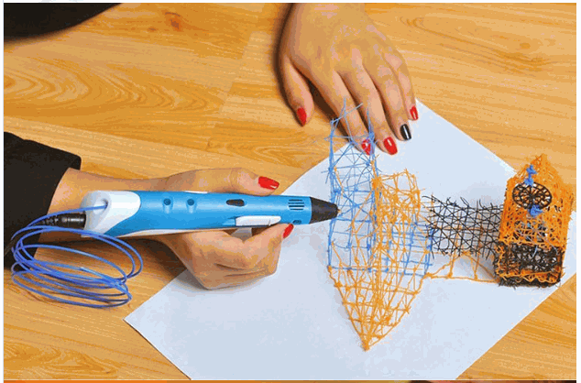
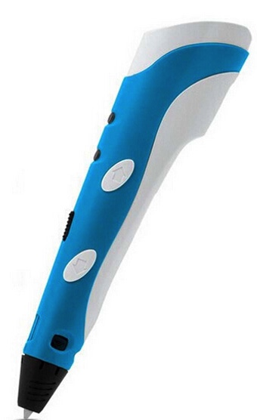
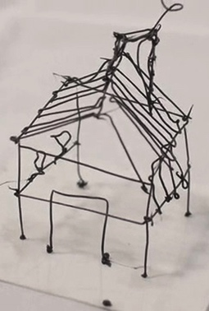
3D Doodler

Slide 22
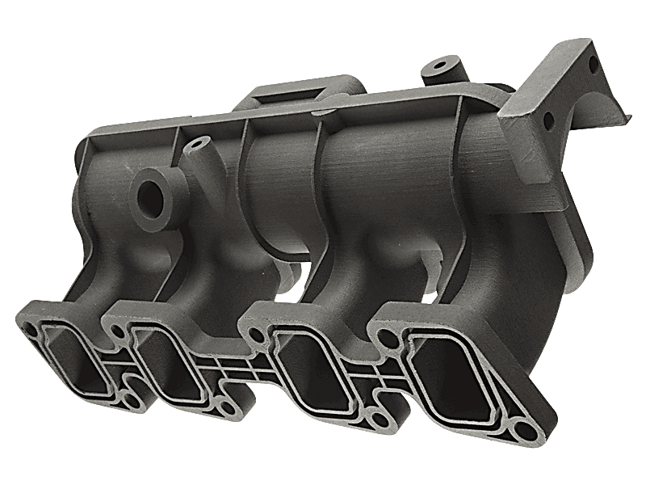
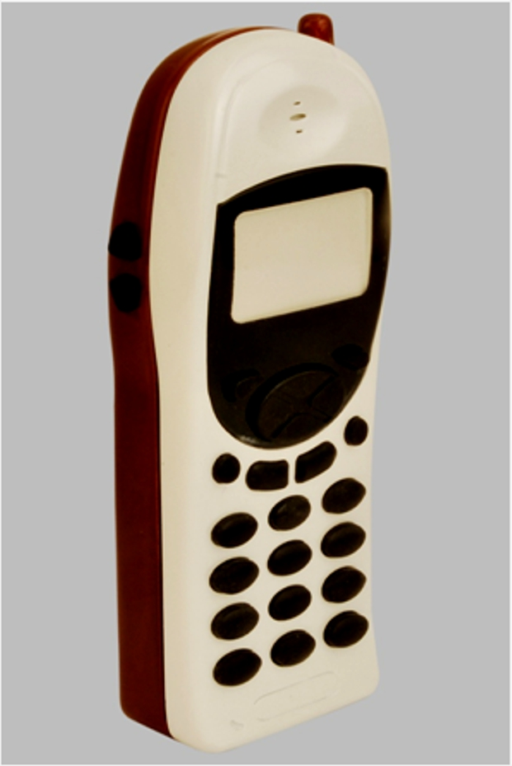
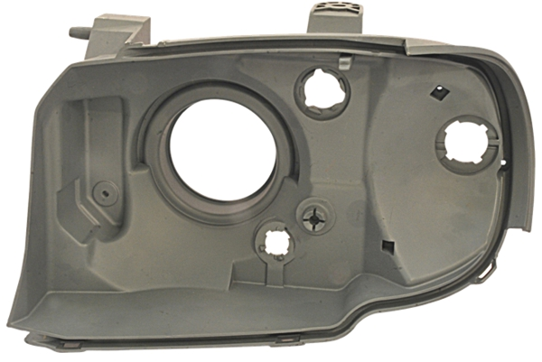
Changing capabilities of 3D Printing since 30 years
Mockup Model of a cell Phone
End user part
Design validation Model
1986
2010
2016

Slide 23
No Economy of Scale

Slide 25
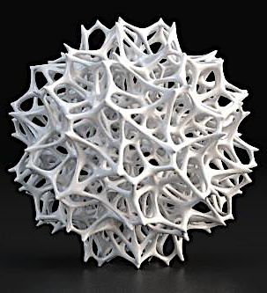

Slide 26
Complexity comes for Free

Slide 28
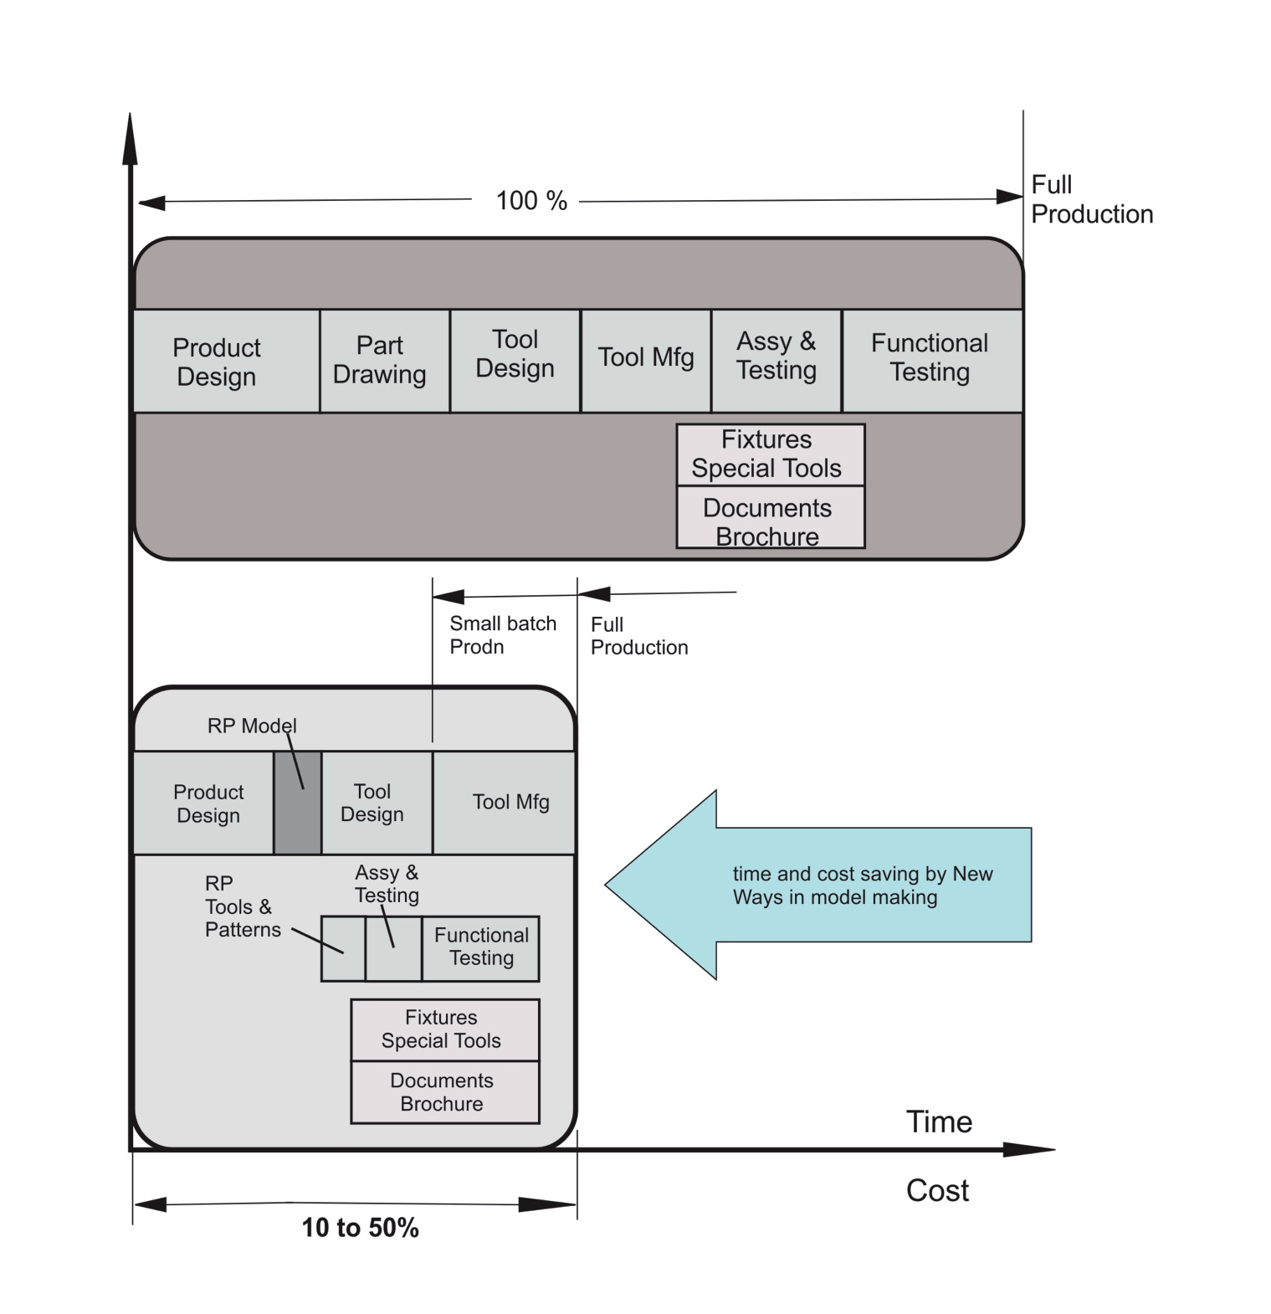
The 3D Printing Advantage
Ref: Rapid Prototyping – Rafiq Noorani

Slide 29
New design thinking
Customization
Need for Small Batch and even one part !
Optimization
Value Delivery

Slide 30
Emergence of
The New Customer

Slide 33
Manufacturing World’s new Challenge

Slide 34
Agility

Slide 35
3D printing enabled batch production
3D Printing Process
Vacuum Casting Process
Master Pattern
Mold making
De Molding

Slide 36
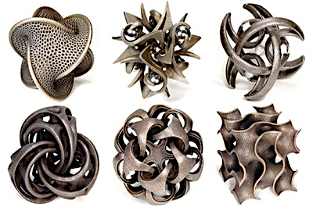

Slide 37
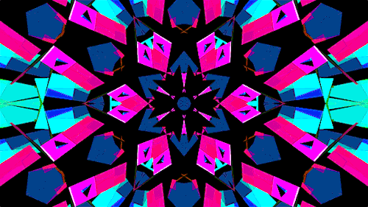

Slide 39
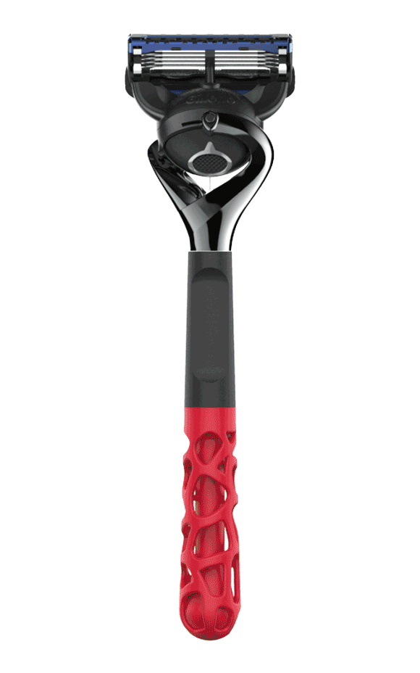

Slide 40
The Future of 3D Printing:
moving beyond prototyping to
Parts for End use....

Slide 41
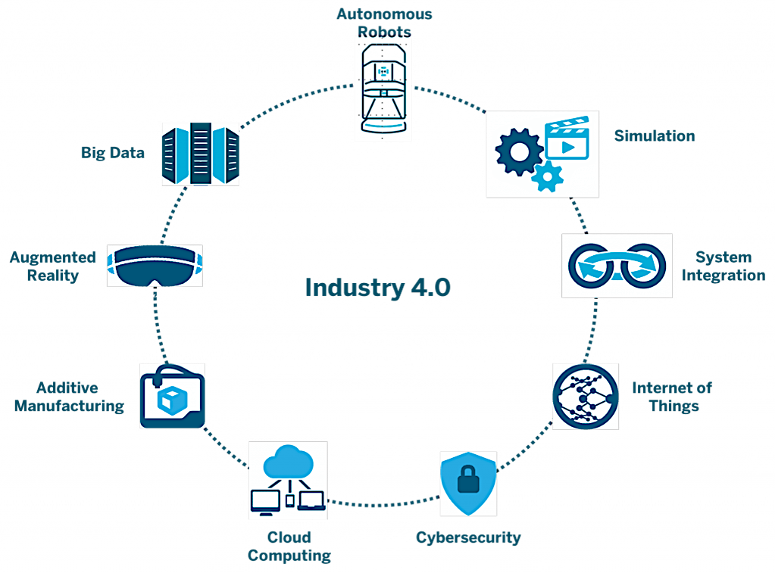

Slide 42
The Digital Switch in SCM
Supply Chain
Demand Chain

Slide 43
The Digital Switch in SCM
Product
Delivery
Value
Delivery

Slide 44
Digital Manufacturing offering World Opportunities…
RE
Materials
Idea /
Design
3D Printing
CAD
Export / Pre process
Post processing
Applications
DfAM
CARE

Slide 45
Thanks!
gp@imaginarium.io / 9930069776

