Slide 1
Jumbo Sanitizer – an Arduino product
Connecting the dots …
At the height of lock down ,it’s a challenge
to make things work with the available resources – you don’t have choices.
Indian hobbyist are die-hard in every given situations.
Electronic hobbyist all over our country can deploy electronics in all possible ways, so that they can help mankind to fight this pandemic.
With this indomitable spirit ,we the Indians are
going to win over the pandemic for sure!

Slide 2
Principal is non-touch
A Jar – The bigger the better [less topups]
A Trigger.
Infrared proximity sensors
Ultrasonic sensor [0 to 4 meter]
Laser distance sensors
Doppler rader
A Spray Mechanism.
By operating a lever [Servo controlled]
By running a pump from top
By running a submersible pump
Spray nozzles.
A power supply.

Slide 3
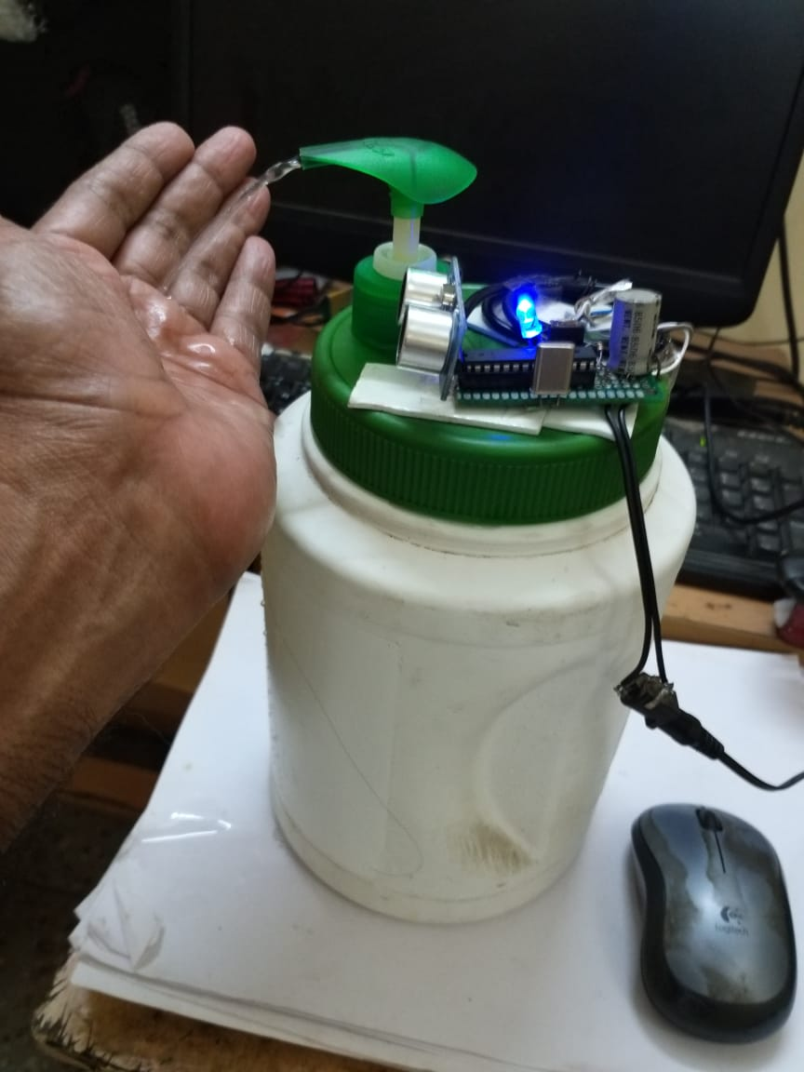
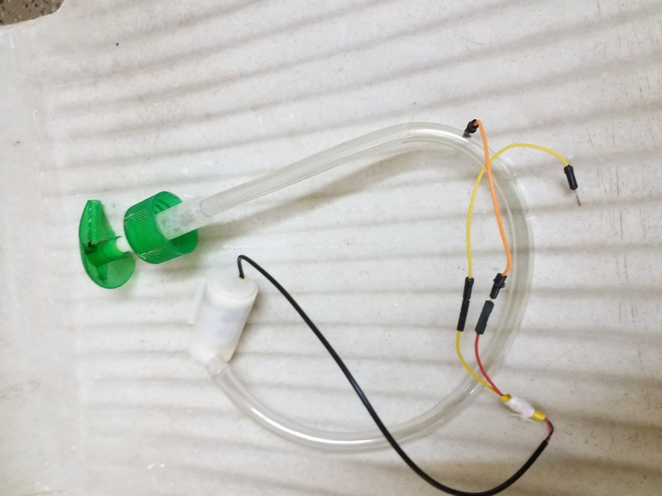
Principal is non-touch and no choice
We salvaged everything that came in our way
Hospital – at registration hall
2.5 liter capacity - one topup / 3 days

Slide 4
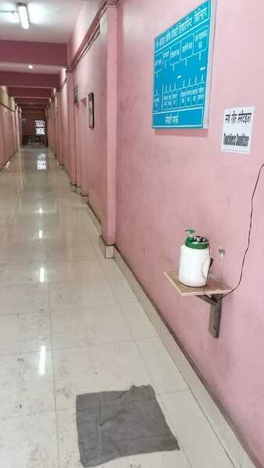
… and people liked it
Hallway entrance
2500 liter capacity - one topup / 25 days

Slide 5
… We went bigger – 5litre
For Conference hall !

Slide 6
… and the biggest – 25 litre
With multiple sprays for our CISF barrack - Two opposite spray nozzles
Work is in progress

Slide 7
We left no stones unturned
What did not work…
Infrared proximity sensor malfunctions in presence of Sunlight.
Liver mechanism to press the handle – by Servo is jerky & unstable.
Salvaged water filter pump does not pump in presence of zero suction pressure.
Very clumsy refill process.
What worked…
Ultrasonic HC-SR04 cheap & efficient for small distance sensing
5 Volt submersible pump silent in operation and sprays easily
Topups are easy
Easy to Jamm the nozzle head to control spray
All open source softwares

Slide 8
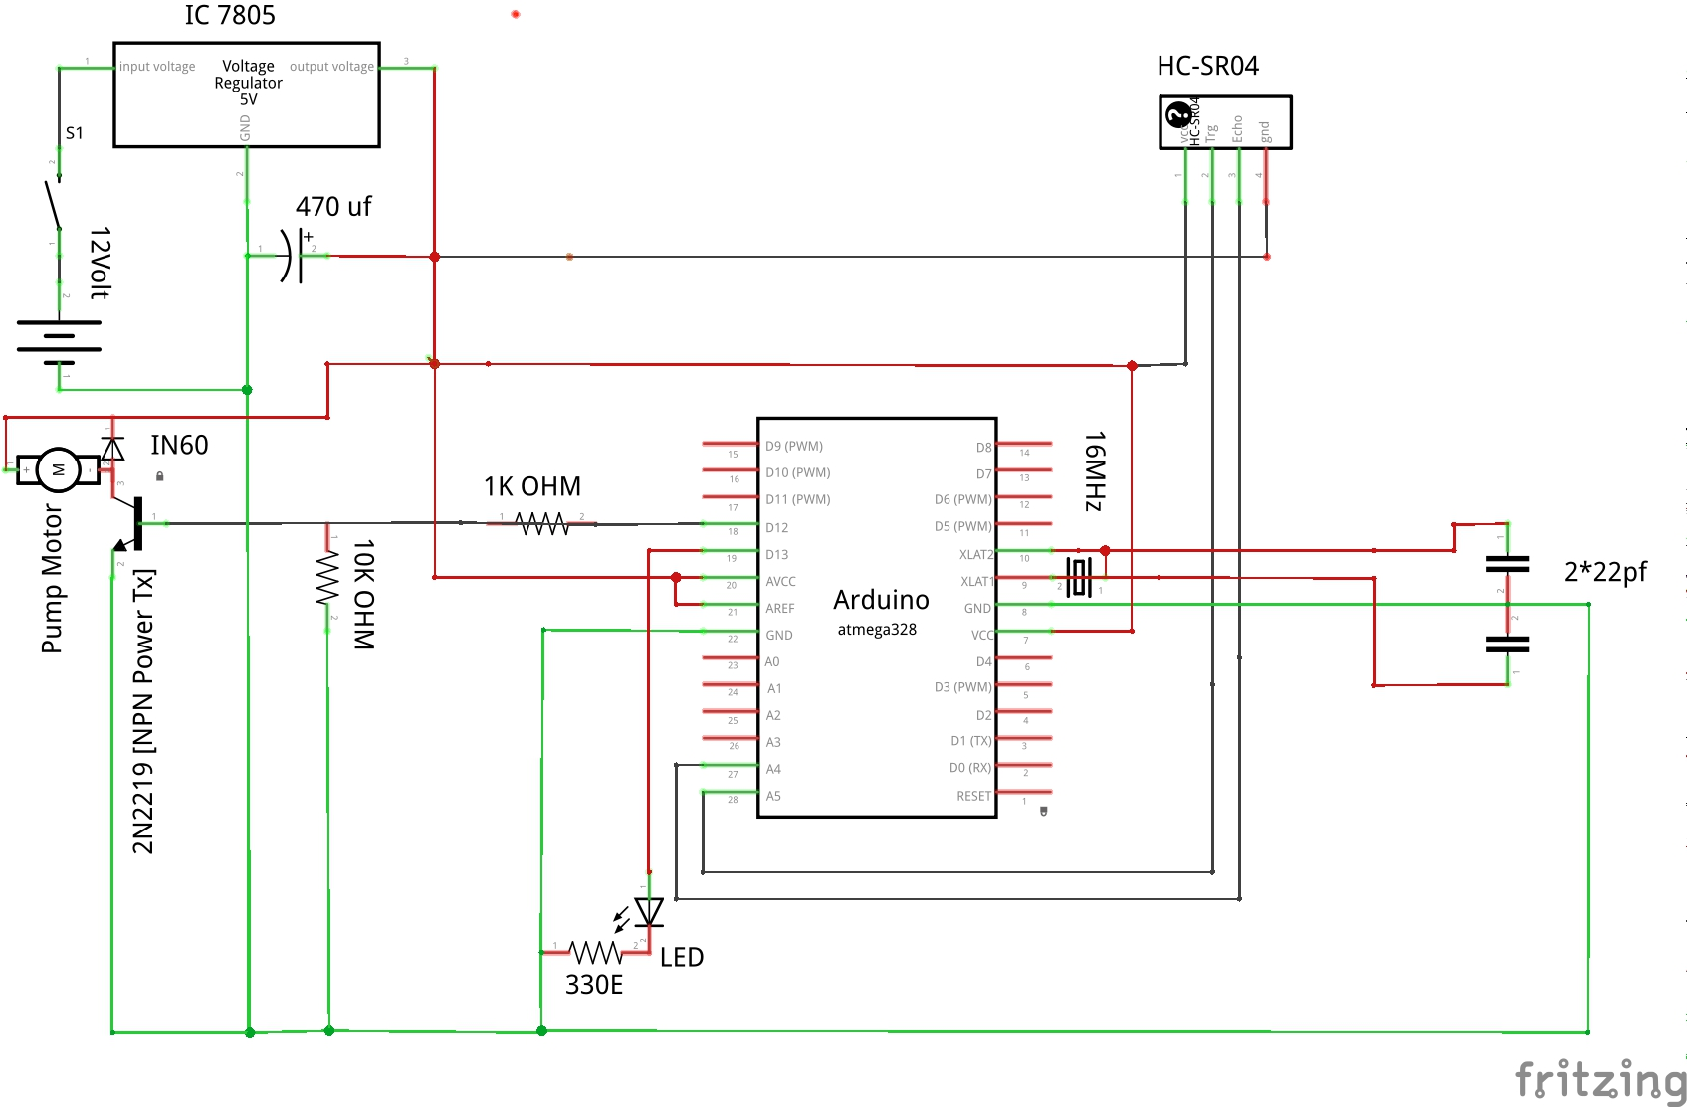
Schematic is very easy & straight forward
BOM:
Arduino UNO
HC-SR04
5Volt SMPS / Regulator IC
5Volt / 12 Volt Pump
Resistors, LEDs,Wires etc.
2SD882 / 2N2219 Transistor
Cost: INR 700 ~ 1000
Software: Arduino sketch, Newping library
To reduce the spray quantity, you may jam the mouth with a ball pen refile…
Added sophistication by attaching an OLED for spray counter

Slide 9
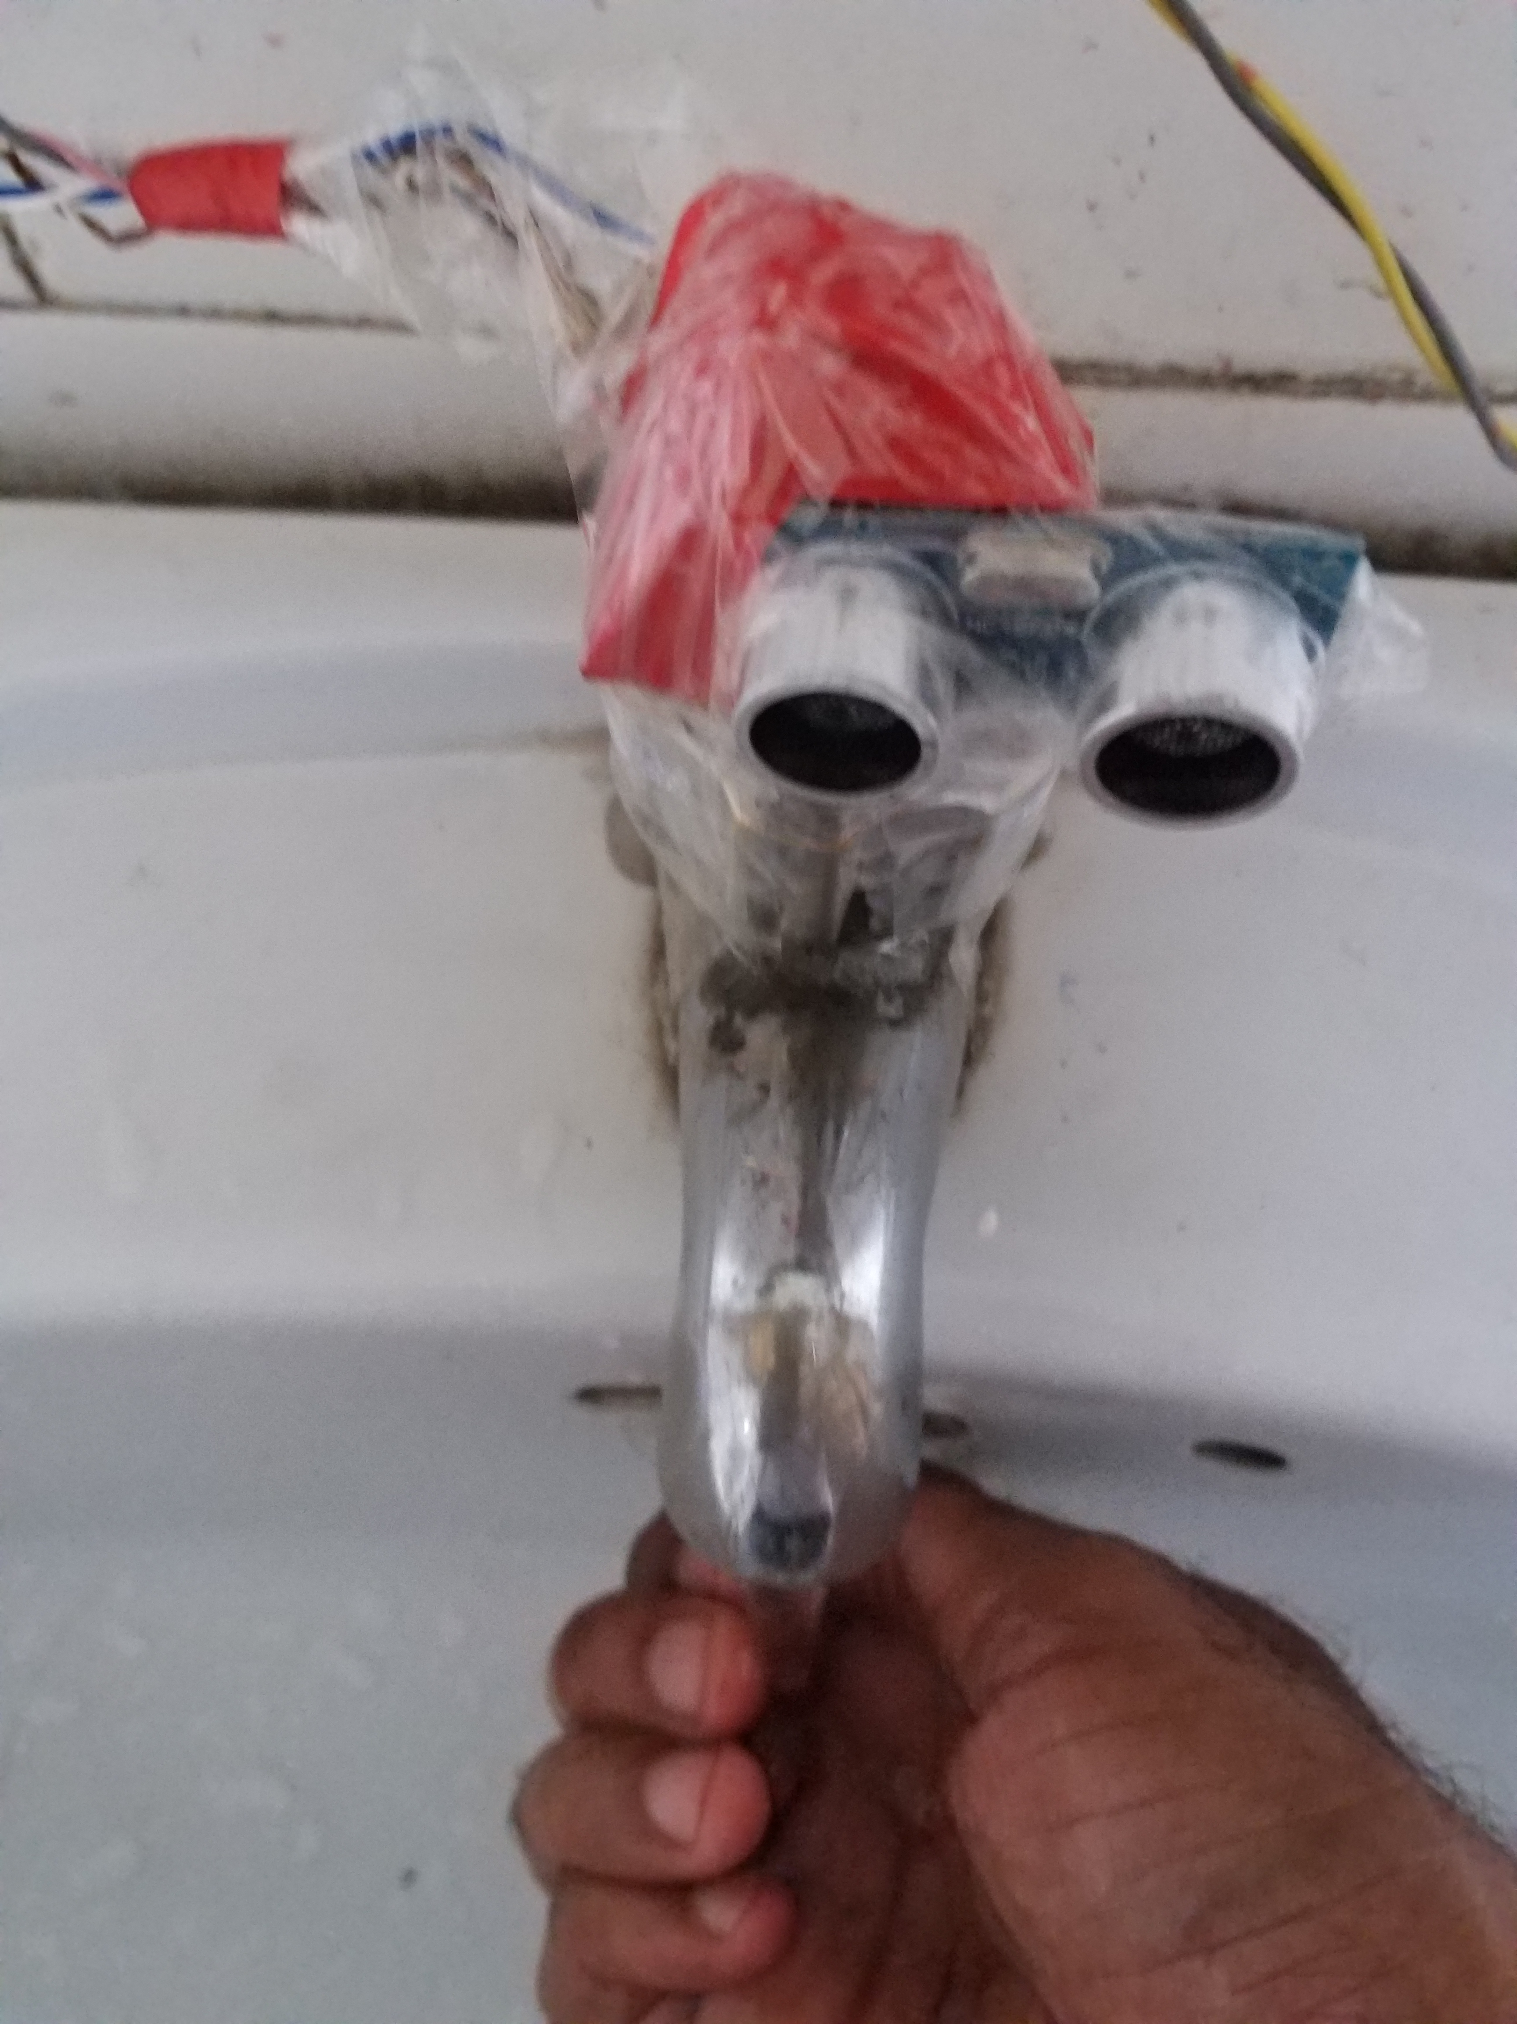
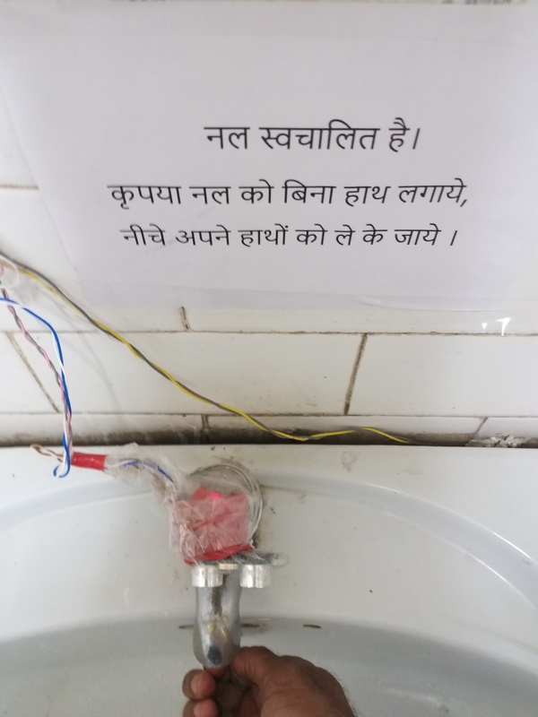
Same principle works for touchless tap
Instead of pump use a 12 Volt solenoid operated valve

Slide 10
Questions ?

