Slide 1
Post Covid Hiring Trends in the Semiconductor Industry
Sampath V.P,SM IEEE,MIE
Senior Design Lead,Tessolve

Slide 2
Agenda
Introduction
Market demands
Emerging Trends and Market surge
Trends
Action Plan
Markets
Skillsets
Technical mindset
Challenges

Slide 3
Introduction
Hot spot in semiconductor with the larger talent market.
Rapid pace innovation fueled by the influx of new ideas and new participants.
Opportunities –Matured Designs support global requirements.

Slide 4
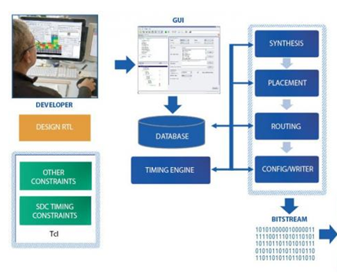
Market demands

Slide 5
Emerging Trends
Different safety standards, Real-time processing and connected cars.
Hiring Demand in certain medical-device categories has sharply.
Software simulators, remote monitoring solutions, virtual reality solutions, and AI-based supply chain management systems.
Collaborative robots in healthcare and manufacturing sectors.
Network operations and security operations
Low-Power Design, Parallel Processing, Memories and Networking.
IPv6, 5G, 4G, connected cars

Slide 6
Emerging Trends
Design Engineers | Board level | Software /Hardware engineer
RTL and High Level Synthesis FPGAs make a cut from Embedded SoCs to Desktop/Server SoCs. | PCB,Packaging Design, implement, debug/test/verify, maintenance. | Embedded hardware and software System with integrated CPU,GPU,FPGA.IoT and 5G .

Slide 7
Trends
FPGA
EMBEDDED HARDWARE

Slide 8
Trendsetters
Evolving Applications | Design Challenges
IoT Automotive Multimedia Server | Sensors, AI/ ML, Security,WiFi Connectivity Sensors,Codecs,AI/ML Security Cloud storage computing, high speed SSD,Security

Slide 9
Trends

Slide 10
Smart Manufacturing

Slide 11
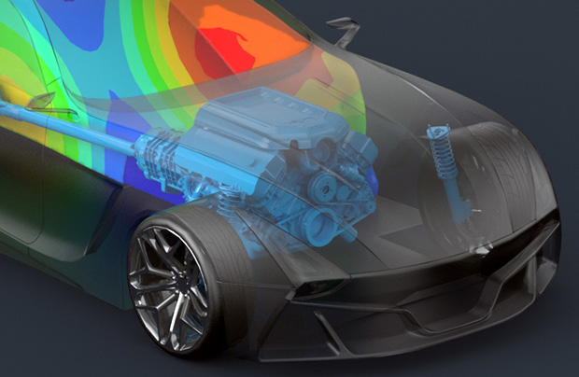
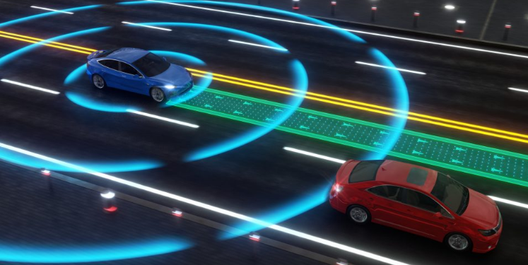
Market Surge

Slide 12
Action Plan
Grow,upskill and use their resources
Hiring models that accommodate the current virtual landscape.
Early talents
Terrible managers and executives to hire effectively, including remotely interviewing candidates
Skill based learning with employers, industry associations, and education/training providers
Industry-academia partnership model - investing in Centres for Excellence, innovation hubs, research parks.

Slide 13
Markets
Storage and cloud computing.
Wired and wireless electronics
Artificial Intelligence in products, 5G networks, growth in automotive and industrial electronics.
Head mounted display, smart watches,advanced driver-assistance systems, HEV.
Smart agriculture market

Slide 14
Skillsets
Hardware Engineers- drone hardware manufacturers
OpenCV,Linux,select hardware to run an ML model
Computer Vision Design and develop models for computer vision
Figure out remote network configurations for development tools for MCUs and FPGAs
Debugging tools, main prototyping and testing equipment.

Slide 15
Technical mindset
Developing a custom RTL block, building a custom reference design
Construct a system level block diagram of the product being developed.
Board level -power supply decoupling, high speed signal terminations and routing.

Slide 16
Challenges
Idea | Solution | Solution
Longtime subject matter experts bring tremendous value . | Consultative hiring of retired SME build and maintain its talent pipeline. | Branding, showcasing -compete for talent against companies like Apple, Google and Facebook.
Difficult - hire algorithm experts, mechanical, optical, research scientists & applications engineers at the mid- to senior. | Hiring -best and brightest in the optics, photonics arena as well as materials experts. | Encourage Next generation semiconductor professionals

Slide 17
Thank you
Sampath V.P
ramsampath78@rediffmail.com

