Slide 1
Secure your Raspberry Pi IoT for Home and Office

Slide 2
Need ??
Added security for your home automation project over WiFi.
Prevent Man in Middle attack, ARP spoofing using softwares like Wireshark and Cain & Abel.
Secure office hardwares like Key dispensing systems, personal lockers etc. over LAN to prevent unauthorise use.

Slide 3
What can possibly go wrong ??
Prank switching on or off your devices in DIY home automation systems.
Disable your home DIY security systems or change detection thresholds.
Fetch unauthorized keys, open unauthorized lockers in office.
Steal your passwords and personal data.

Slide 4
Basic Setup
Install a Web Server to kickstart your IoT
Preferable Nginx which is lightweight and suitable for low resource system like Raspberry Pi
Install PHP as it is common and easy server side script language and it also supports Raspberry Pi GPIO control.
Optional Database for storing data like MySQL etc.

Slide 5
Now secure it
Create the SSL Certificate using OpenSSL and certificate signing request (CSR)
sudo openssl req -x509 -nodes -days 365 -newkey rsa:2048 -keyout /etc/ssl/private/nginx-selfsigned.key -out /etc/ssl/certs/nginx-selfsigned.crt

Slide 6
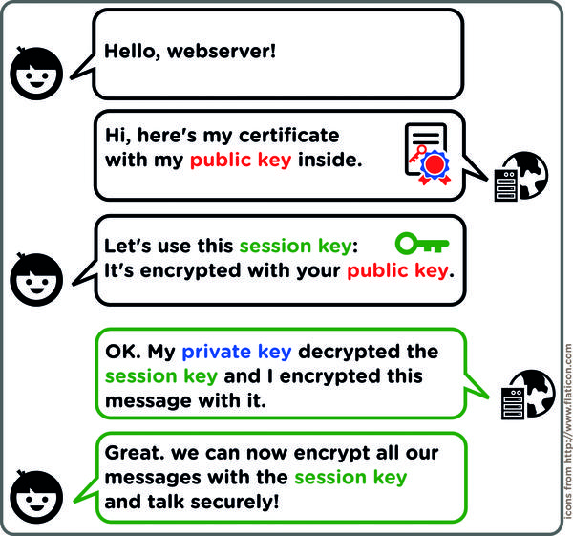
Basic working understanding

Slide 7
Now Secure it
Negotiating Perfect Forward Secrecy with clients called Diffie Hellman Key exchange protocol
In cryptography, forward secrecy (FS), also known as perfect forward secrecy (PFS), is a feature of specific key agreement protocols that gives assurances that session keys will not be compromised even if the private key of the server is compromised.

Slide 8
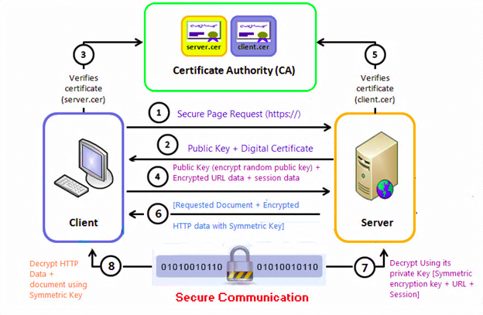
A bit details

Slide 9
Points to remember
Encryption and Decryption of data needs system resources and memory.
Use higher RAM model boards if possible.
Use proper heatsink and cooling system to prevent failsafe thermal throttling.
Uninstall all non essential softwares and packages from the OS.
Use watchdog timer.
Disable WiFi/Bluetooth in case of wired network system.

