Slide 1
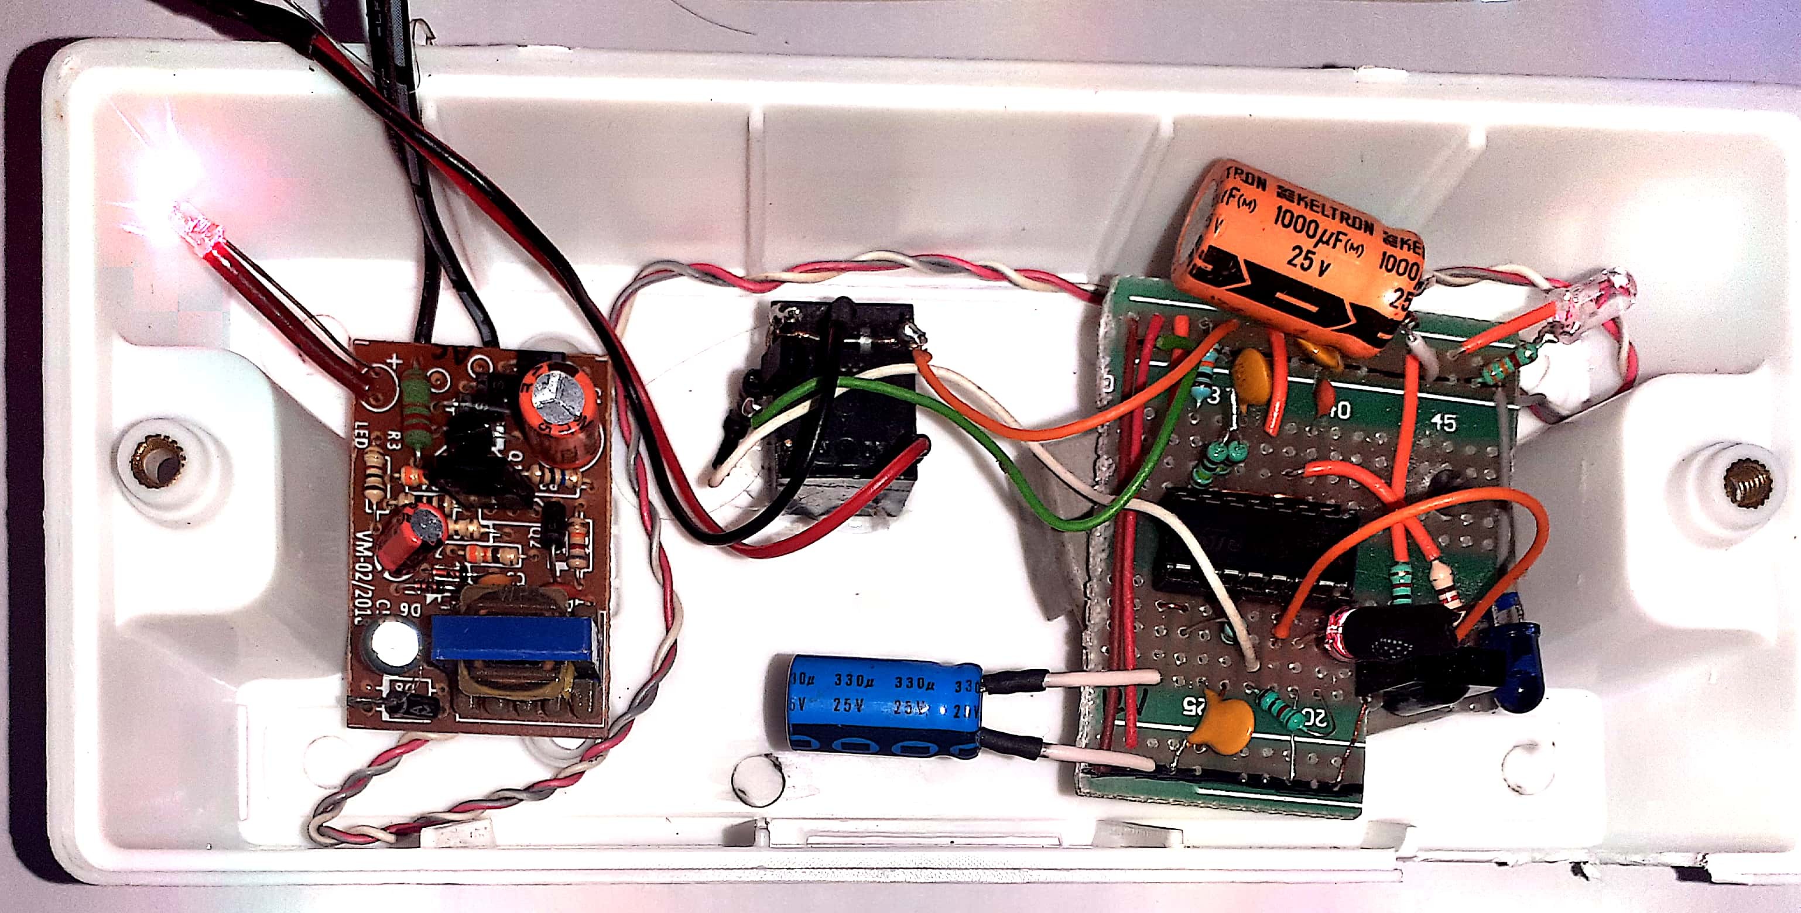
Touchless Door Bell Using IC 556N
K. Murali Krishna, JE, BSNL

Slide 2
Technology in pandemic
Technology cannot prevent pandemic. however,
it can help…….
  prevent spread,
  educate,
  warn,
  empower
  create awareness
noticeably lessen the impact.
converging technology-innovative approach to pandemic response
Passing right Information
Finding new remedies
Facial Recognition
Ai-based Data Analytics
Contact-less Movement And Deliveries Through Autonomous Vehicles, Drones And Robots
Temperature Monitoring Incubators
Remote Working Technologies

Slide 3
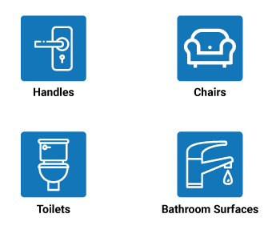
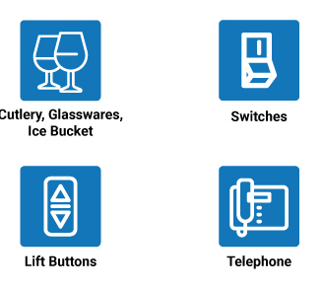
Motive beside the design
Coronavirus Pandemic Situation
Social Distancing And Physical Distancing
The Term "TOUCH" -The Most Fearful Word Ever.
Spreads Through Contact Transmission.
High Touch Points Like Door Knobs, Lift Buttons, Door Bells.

Slide 4
This circuit represented is a low cost, simple , reliable, and effective circuit which switches on and off the doorbell without touching it.
Doorbell switch --- "push-to-make" switch
Simple “push button” switch

Slide 5
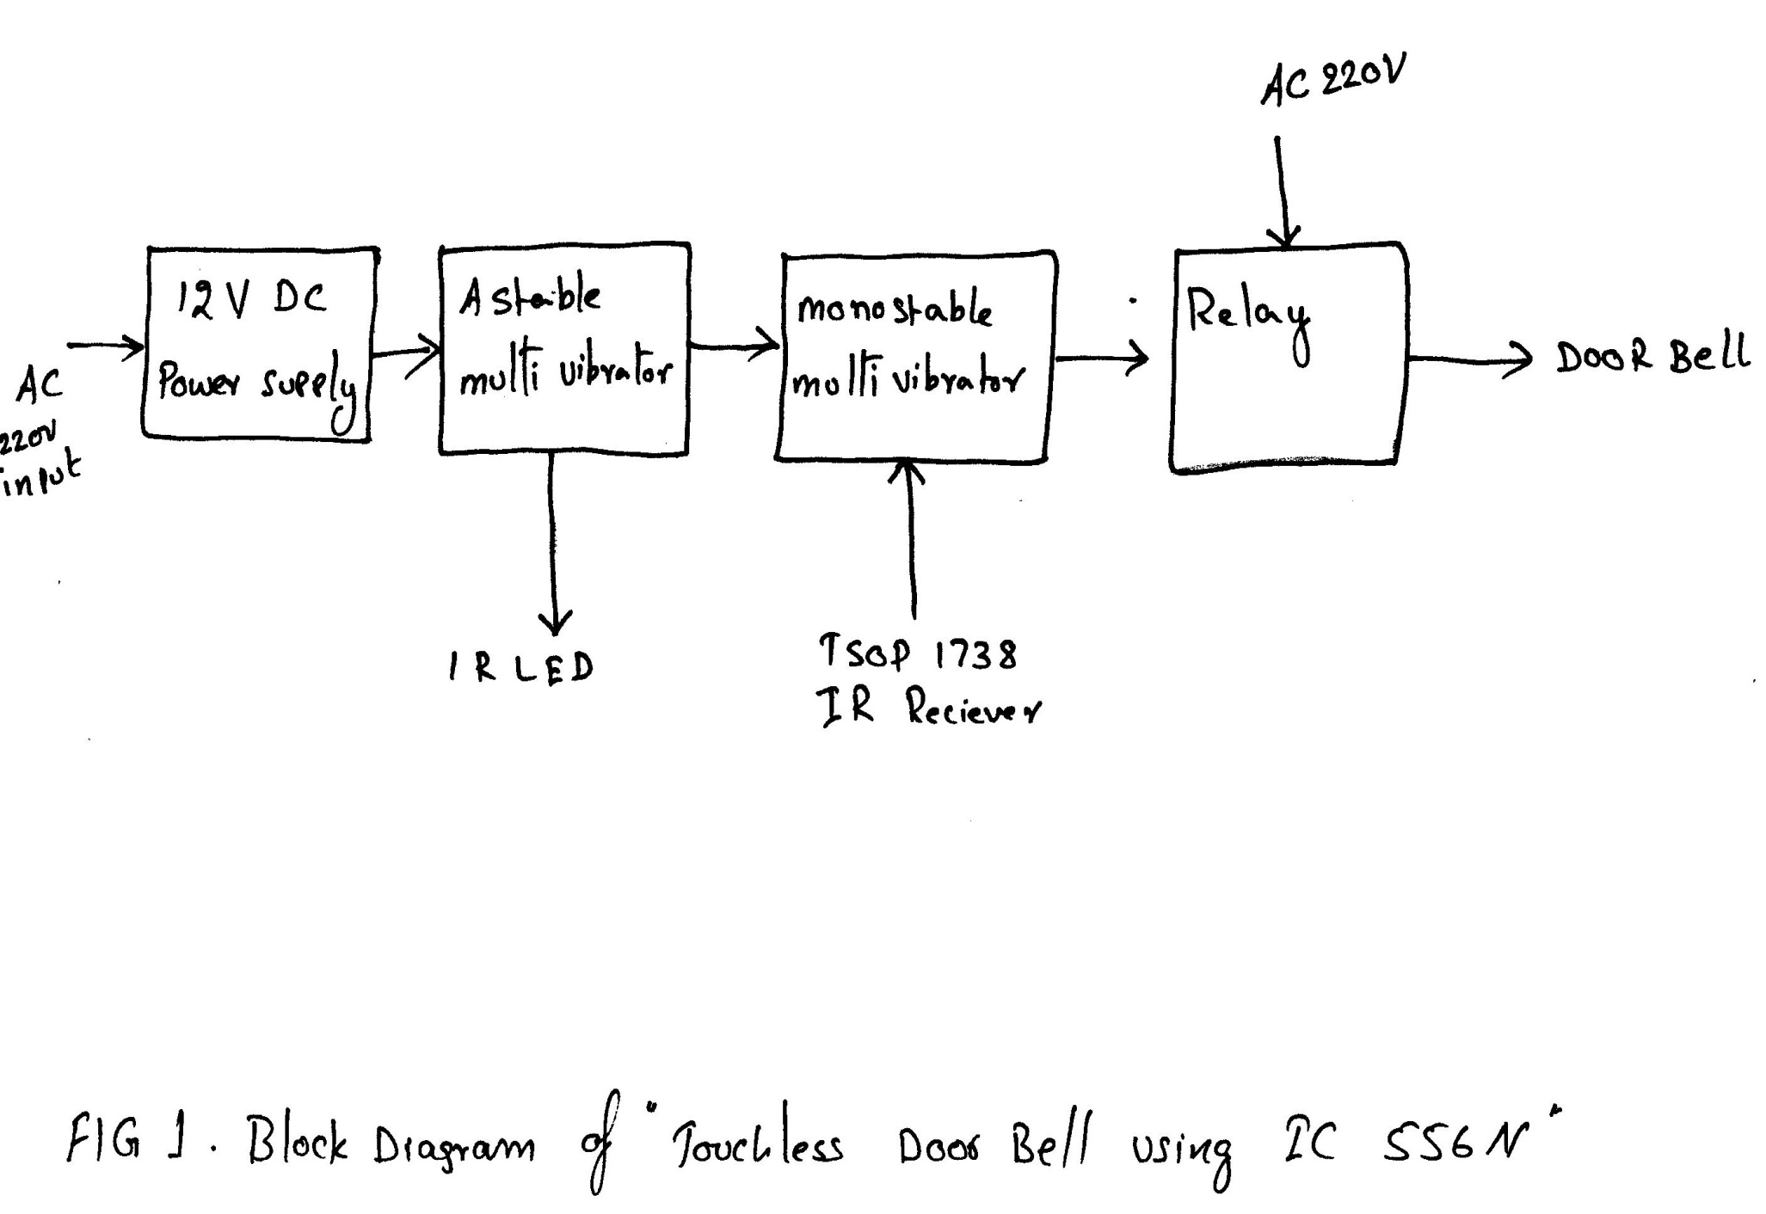
BLOCK DIAGRAM OF TOUCH LESS SWITCH USING IC 556

Slide 6
Astable multivibrator
Astable multivibrator is also called as Free Running Multivibrator.
three external components: two resistors and a capacitor

Slide 7
Monostable Multivibrator
Monostable Multivibrator Has Only One Stable State.
Trigger Input ... A Pulse Is Produced At The Output And Returns Back To The Stable State After A Time Interval.
Timing Circuit That Comprises Of A Resistor (R) And A Capacitor (C).

Slide 8
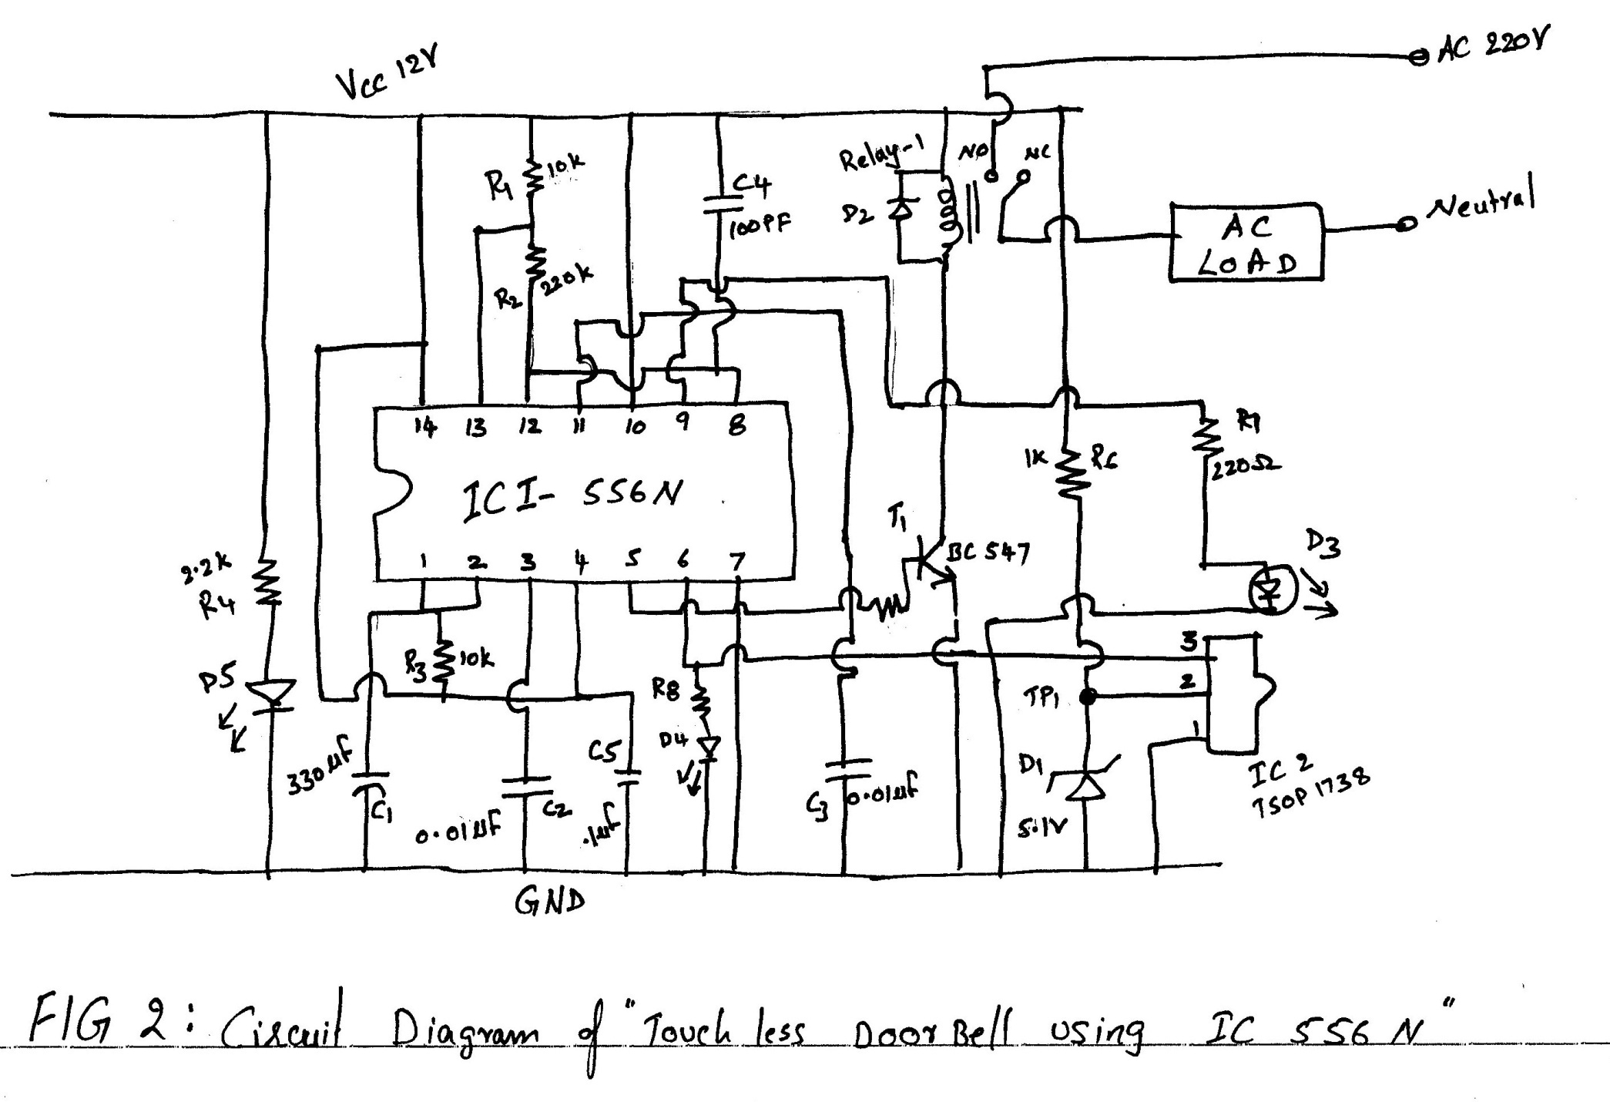
CIRCUIT DIAGRAM OF TOUCH LESS SWITCH USING ic 556

Slide 9
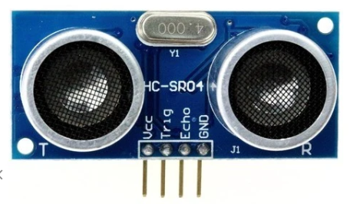
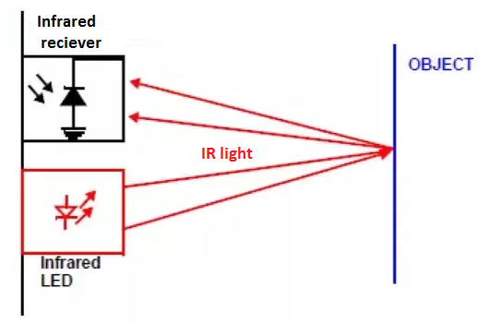
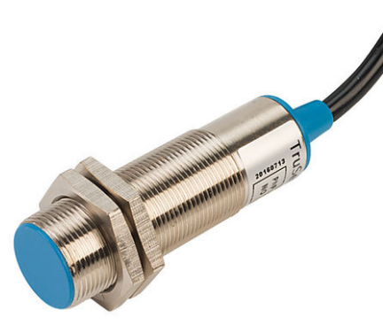
Proximity Sensor
proximity sensor is a sensor able to detect the presence of nearby objects without any physical contact.

Slide 10
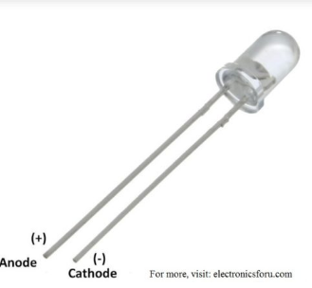
IR LED
An IR LED (infrared light emitting diode) is a solid state lighting (SSL) device that emits light in the infrared range of the electromagnetic radiation spectrum.
Vf- forward voltage
Rs--Series resistance

Slide 11
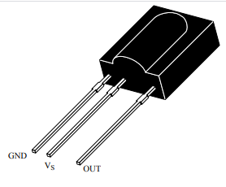
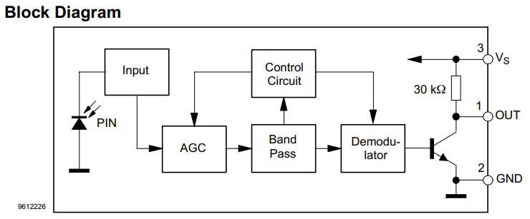
IR Receiver TSOP1738 operates at 38 kHz, 5V operation
High immunity against ambient light

Slide 12
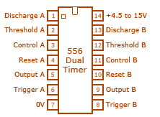
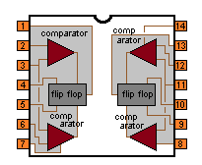
IC 556 pin diagram
These timers works independently.
These timer share common voltage and ground terminal.

Slide 13
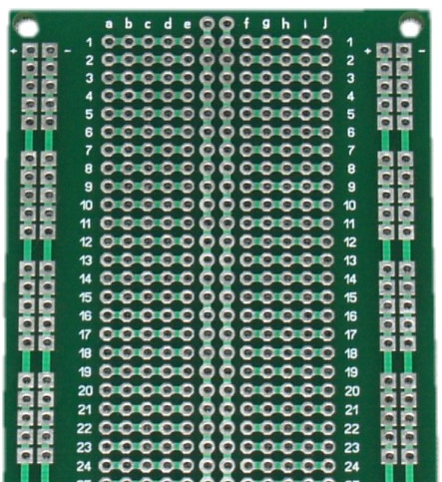
Bread board PCB
PVC switch board
12v 1A SMPS power supply
14 pin IC base

Slide 14
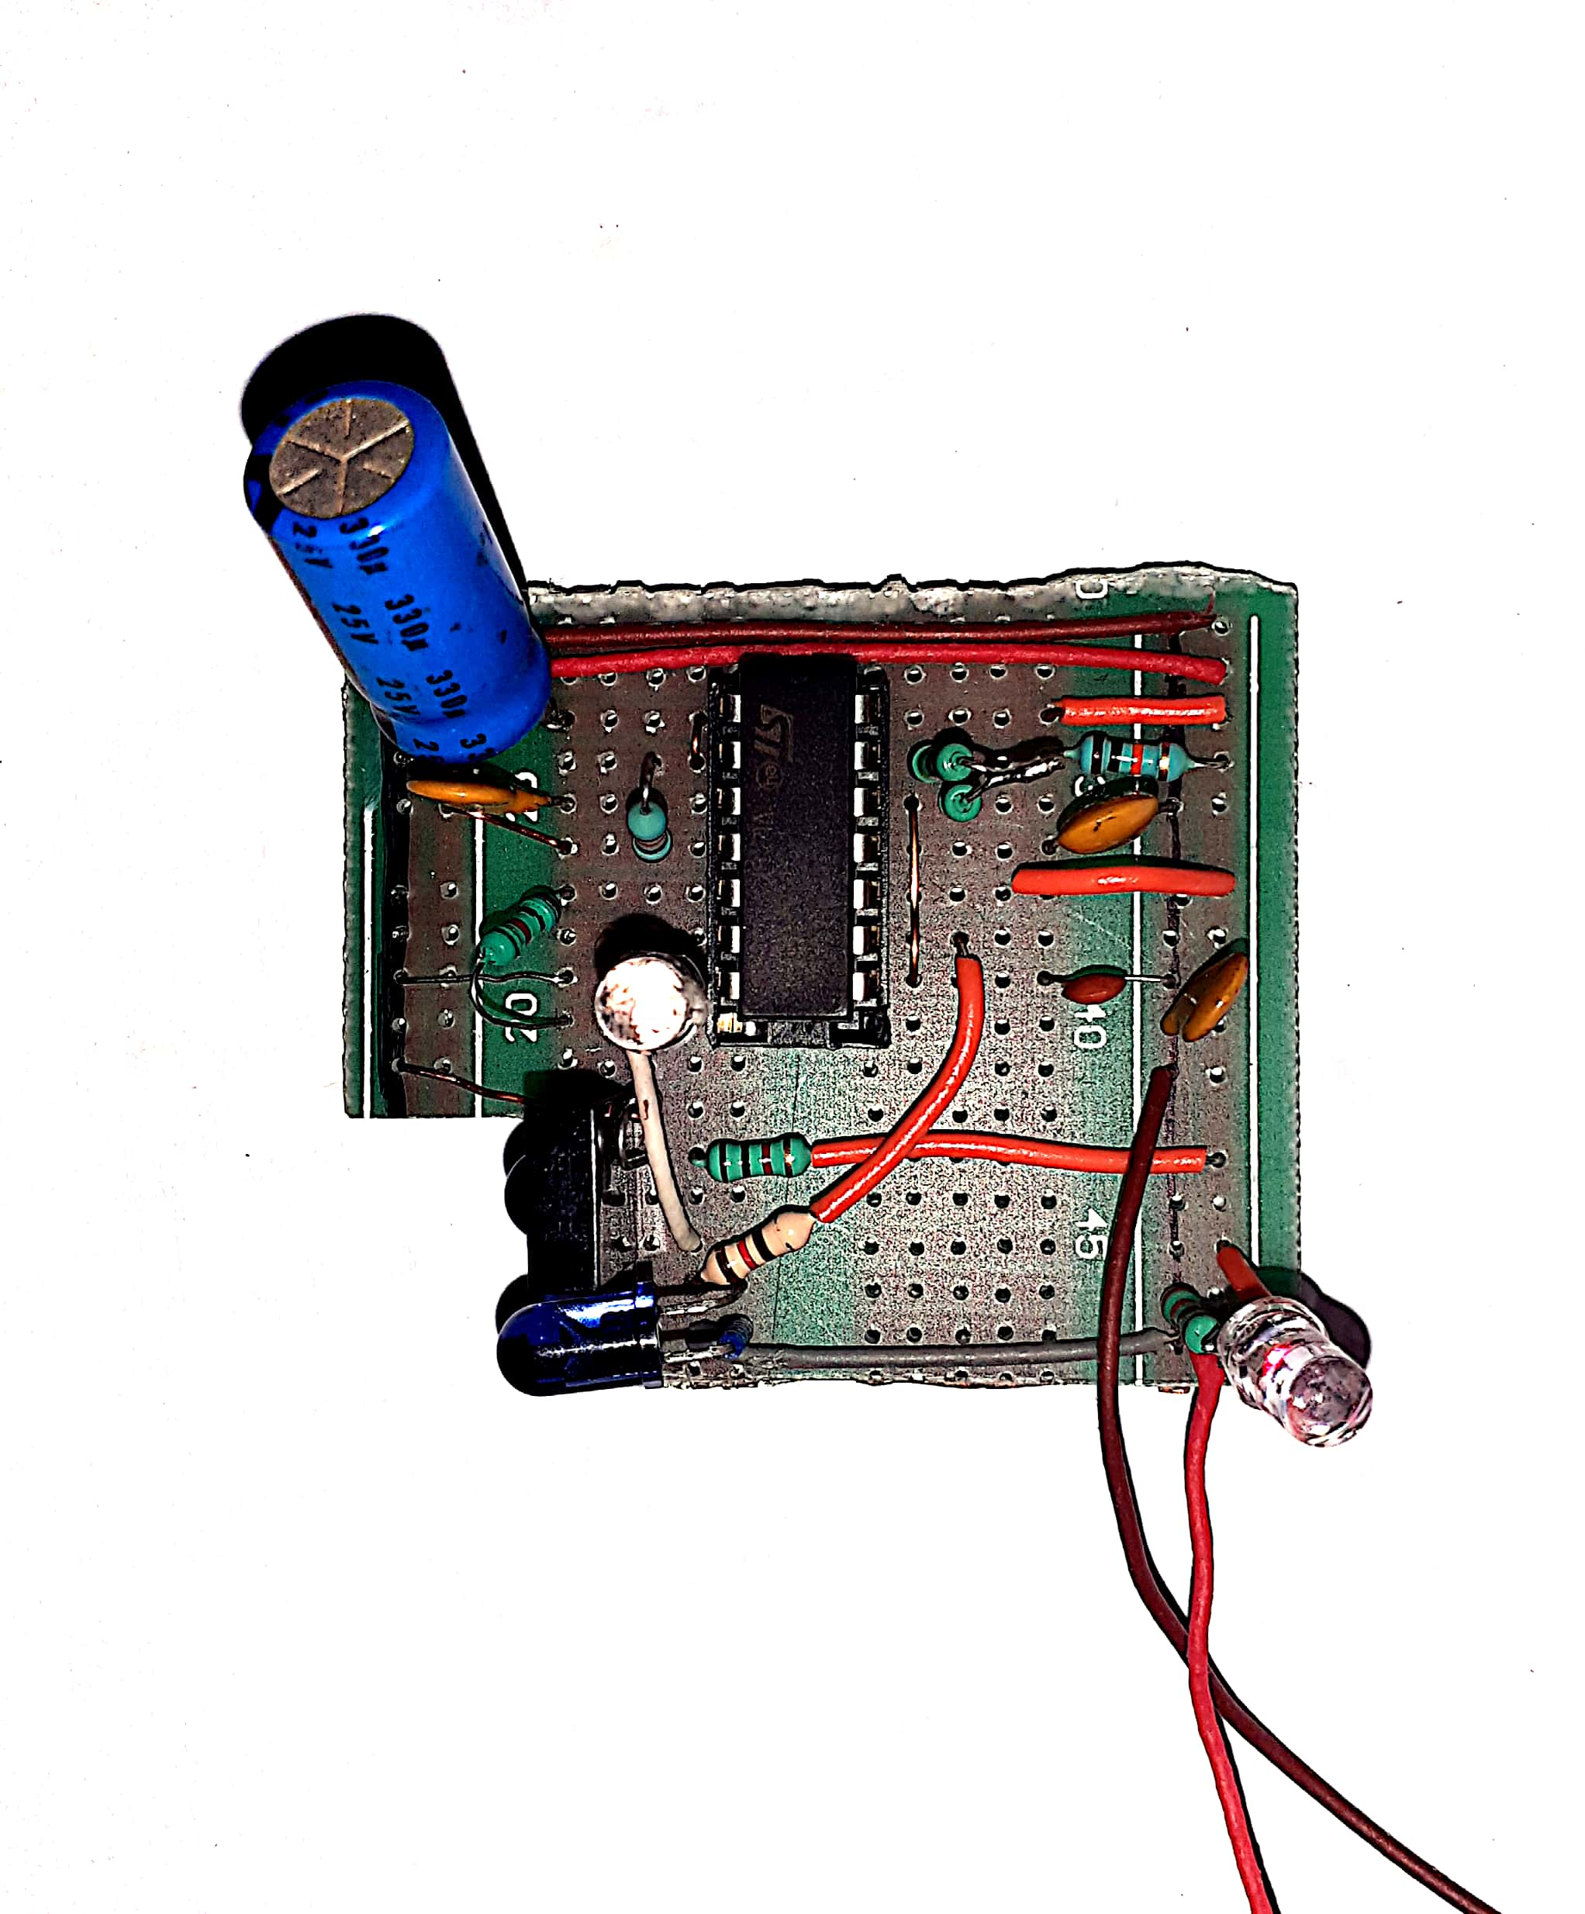

Slide 15
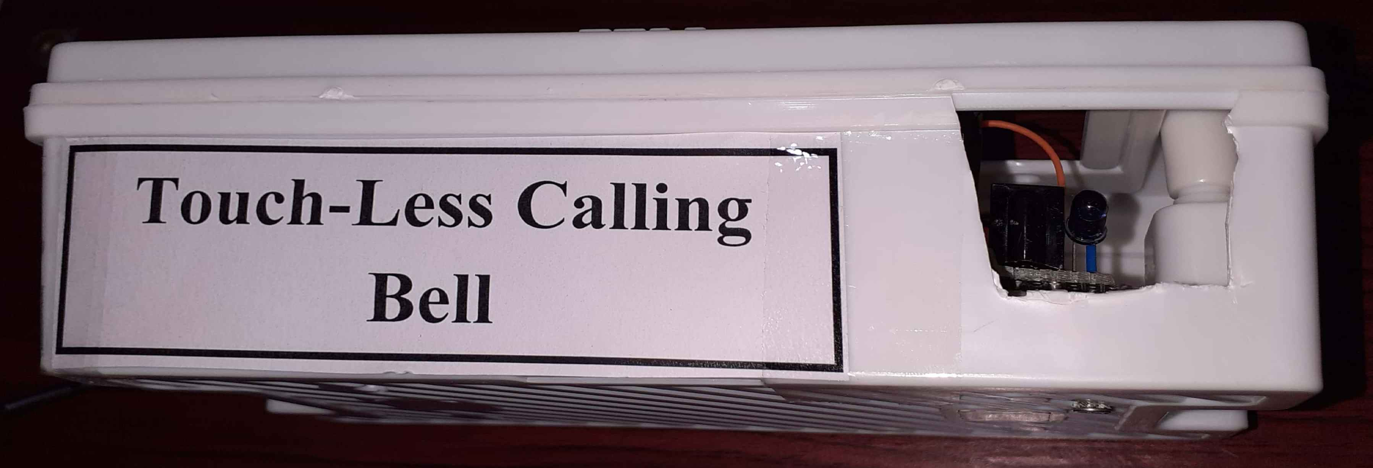

Slide 16
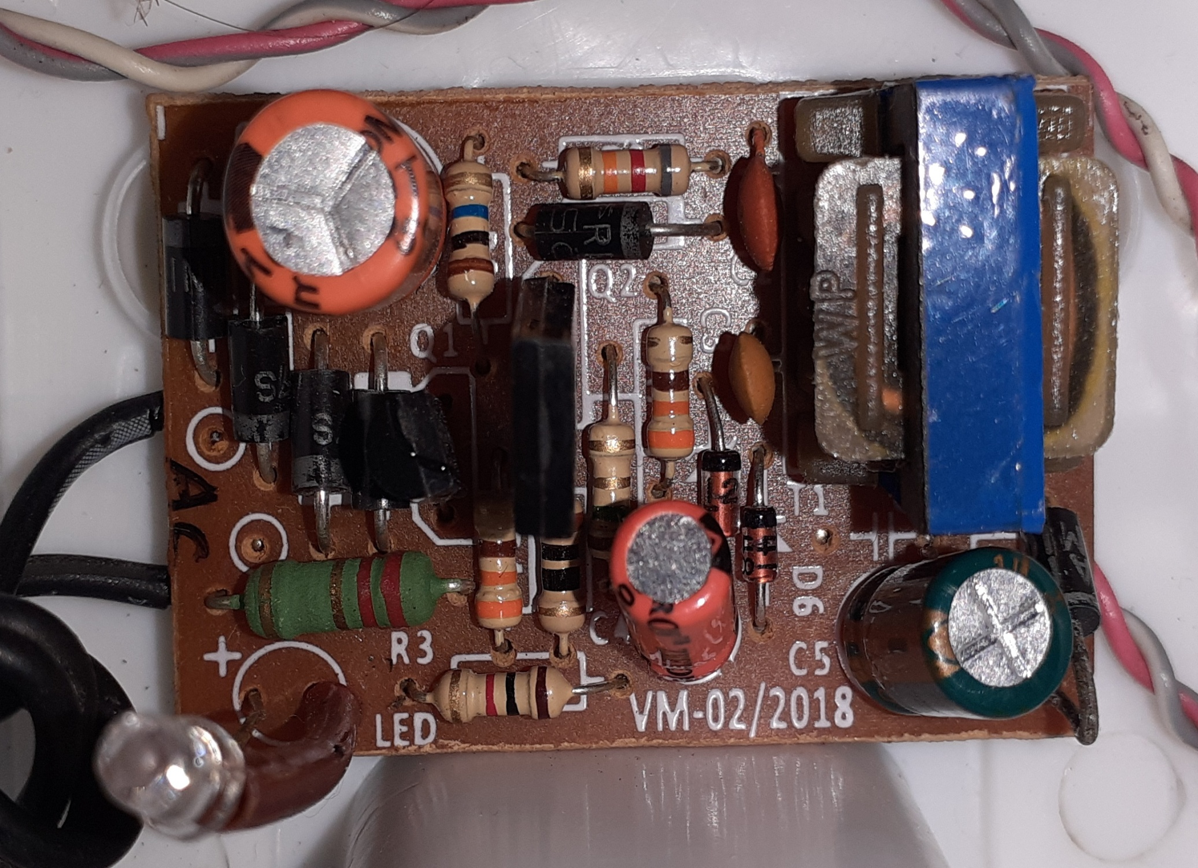
12 VDC 500mA SMPS board

Slide 17
Proximity adjustment
Two methods:
By changing the R7 value
By changing the frequency of operation of the astable multivibrator.
Here, in the circuit the proximity is around 3 to 4 cm.

Slide 18
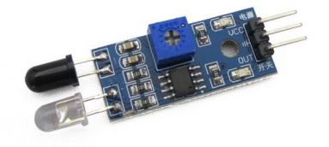
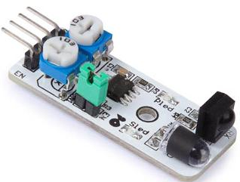
Advantages than using modules
Low cost
Stable operation
No SMD components
Easy to vary the parameters
Easy to repair
Limits can be defined by us
Improves our basic knowledge
We build to a common operating voltage

Slide 19

Demo – working

Slide 20
Thank you
K. Murali Krishna, JE, BSNL
Imagination & creativity
is better than knowledge

